Slide 1



Bridging the Talent Gap
Accelerating Workforce Solutions for Semiconductors
Florida Semiconductor Summit 2026

Slide 2





Michelle Williams
Executive Director
mwilliams@semi.org

Slide 3



Every innovation begins with a chip: AI, EVs, clean energy, medicine, space, etc.
Notes:
The semiconductor industry is the backbone of every modern innovation and every modern day convenience: AI, EVs, clean energy, medicine, space exploration. Everyone in this room knows that, but how do we get kids, potential workers, their teachers, to also know this. That’s one of the challenges that we face in WFD activities

Slide 4




People Power Progress.
Innovation isn’t possible without people.
Skilled. Inspired.
The demand for semiconductor talent has never been greater. More than 170,000 new workers will be needed in the U.S. in the next five years.
Notes:
We know and we can truly say that none of this progress is possible without people who are skilled, inspired, and ready to lead.
Demand is outpacing supply: more than 170,000 new workers are needed in the U.S. in the next five years. This is in addition to those who will retire, shift away from our industry.
That’s the challenge that we are working together to solve: bridging the talent gap with scalable, innovative, and inclusive solutions.

Slide 5











Building the Workforce that Powers Our World
Mission: To support economic opportunity for workers and the sustained growth of the microelectronics industry through creating pathways and opportunities for job seekers, and tools and systems for semiconductor companies to attract, develop, retain, and advance a broad, skilled workforce.
50+ workforce initiatives worldwide in SEMI regions
Extensive national programming in the United States
Building opportunity at the regional and state level
Ensuring a skilled
talent pipeline
for industry
Founded in 2001. Global Impact Today.
Notes:
Our mission at SEMI Foundation is to support economic opportunity for workers and the sustained growth of the microelectronics industry. We create pathways and opportunities for job seekers and provide tools for semiconductor companies to attract, develop, retain, and advance a skilled workforce. We have over 50 workforce initiatives worldwide, and our impact global.
We have extensive national programming in the United States, building opportunity at the regional and state level, and ensuring a skilled talent pipeline for the industry. Founded in 2001, our global impact today is significant. Our team and our regional offices around the globe are the driving force behind these initiatives, working tirelessly to make a difference
This work is not just about filling jobs—it’s about creating lifelong career pathways.

Slide 6





Impact at a Glance
6.5+ Million
394,000+
260,000+
Storytelling & Media
6.5M+ engaged worldwide through SEMI Stories and the “Chip In” documentary.
Broad Global Reach
Engaging 394,000+ participants across Europe and Asia — from 380,000 in Europe to thousands more in SEA, China, Japan, Korea, and Taiwan.
NextGen Inspiration
260,000+ students and early talent engaged through portals, pop-ups, camps, and events.
Notes:
There’s collective power in all of these programs and I wanted to take a moment to share the impact of our work. We engage millions worldwide through various programs and initiatives.
6.5M+ people reached through storytelling and media like SEMI Stories and Chip In.
394,000+ participants across Europe and Asia—showing our global reach.
260,000+ students and early talent engaged directly through events, camps, and portals.

Slide 7



Global Impact at a Glance
1.25+ Million
3,300+
7,000+
Careers & Upskilling
1.25M+ participants reached through SCAN, VetWorks, and new industry certifications.
Expanding Access
3,300+ participants and families engaged through childcare support and programs that expand access.
Knowledge Amplifiers
7,000+ teachers and learners engaged through SEMI U and teacher trainings.
Notes:
1.25M+ workers upskilled and connected to careers through apprenticeships, certifications, Vetworks
3,300+ families supported with childcare and access initiatives.
7,000+ teachers and learners engaged through SEMI U and teacher trainings.
The numbers speak for themselves: we are scaling both impact and access in measurable, meaningful ways.
The sheer volume of our work is a testament to our commitment and the trust our member companies have placed in us.

Slide 8






5 Pillars Powering Our Programs and Initiatives
Early Awareness & Industry Exposure
Inspiring the next generation by making semiconductors real, relevant, and exciting.
Pathways
to Careers
Turning curiosity into careers with clear, industry-aligned training and opportunities.
Expanding
Opportunity & Access
Breaking barriers so everyone has a fair shot at success in semiconductors.
Global Workforce Solutions
Driving a worldwide movement to grow the semiconductor workforce.
National Talent Ecosystem for Scale
Unifying education, workforce, government and industry into a nationwide engine for talent.
Notes:
Our programs and initiatives are powered by five key pillars: National Talent Ecosystem for Scale, Early Awareness & Industry Exposure, Pathways to Careers, Expanding Access & Opportunity, and Global Workforce Solutions. These pillars represent our comprehensive approach to workforce development

Slide 9



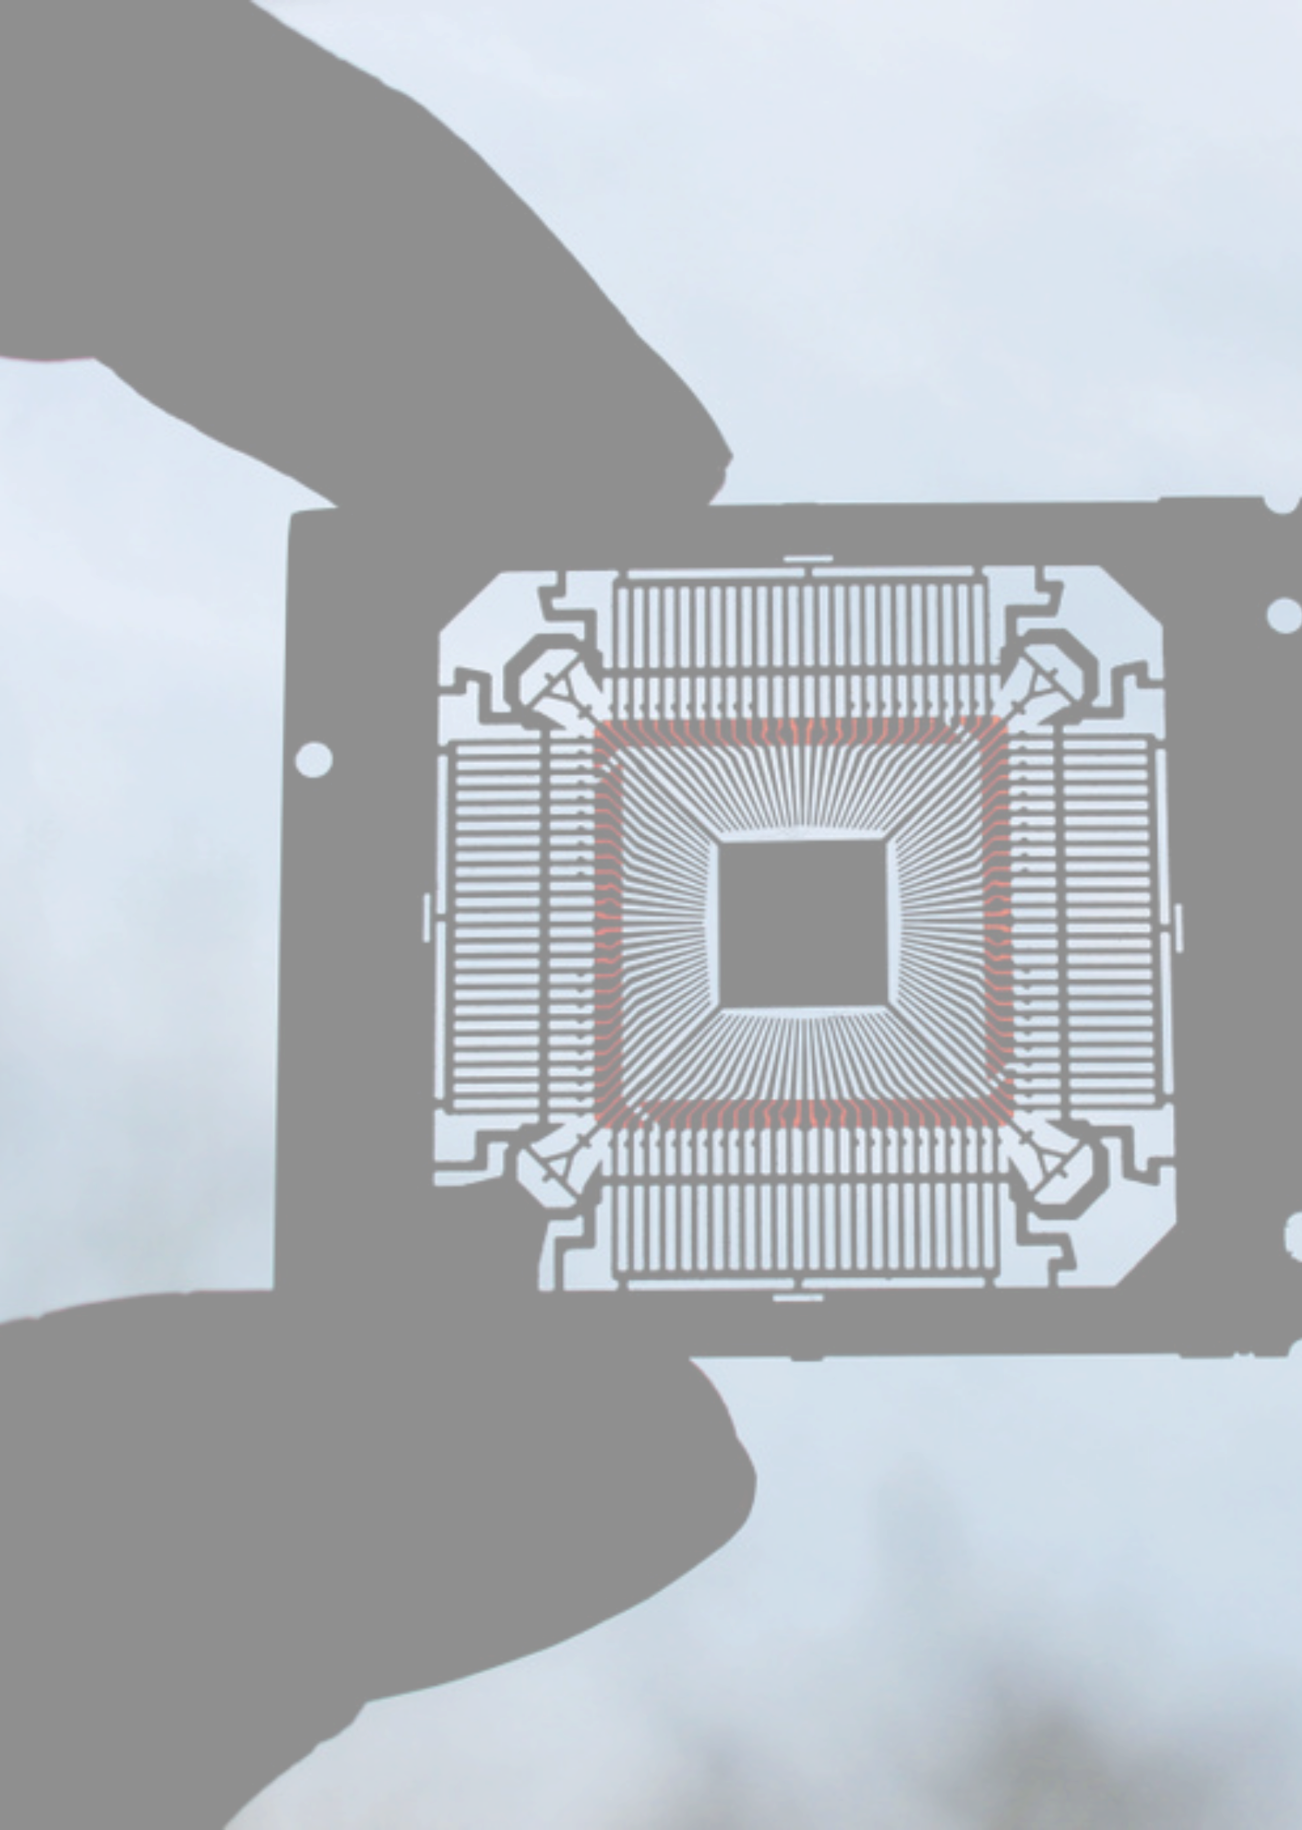

Conversion from Awareness to Workforce Participation
Our Unique Approach to Move Beyond Awareness
AWARENESS (Spark)
↓
CURIOSITY (Why it matters to me)
↓
INTEREST (I want to try this)
↓
EXPLORATION (I’m doing something with it)
↓
PATHWAY EXPOSURE (I see where this can lead)
↓
COMMITMENT (I’ve chosen a route)
↓
PARTICIPATION (I’m learning, interning, or working)
↓
WORKFORCE ENTRY

Slide 10


National Network for Microelectronics Education (NNME)
2026

Slide 11


A National Response to the Workforce Challenge in​ Microelectronics
America’s economic competitiveness and national security depend on a strong, highly skilled semiconductor workforce. The U.S. will need more than 170,000 additional workers by 2030—making workforce development a national imperative. In response, the CHIPS & Science Act, with leadership from the National Science Foundation (NSF) and the Department of Commerce, has mobilized historic investments to secure the nation’s future.
Through this investment, the National Network for Microelectronics Education (NNME) was created.

Slide 12

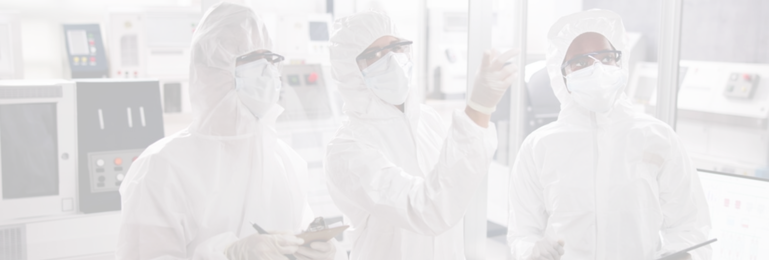









America’s Gold Standard for Employer-Aligned Microelectronics Curriculum and Training
The NNME’s mission is clear: equip all Americans with employer-aligned curriculum and hands-on learning that lead to microelectronics careers—advancing U.S. innovation, competitiveness, and prosperity. Our vision is a unified, adaptable national talent ecosystem where education, industry, and opportunity move in lockstep to meet the evolving needs of the semiconductor sector.
Significance of the
Unifies fragmented
training & curricula
Creates a national
standard for
excellence
Expands access
for students and
workers
Ensures a skilled
talent pipeline
for industry

Slide 13

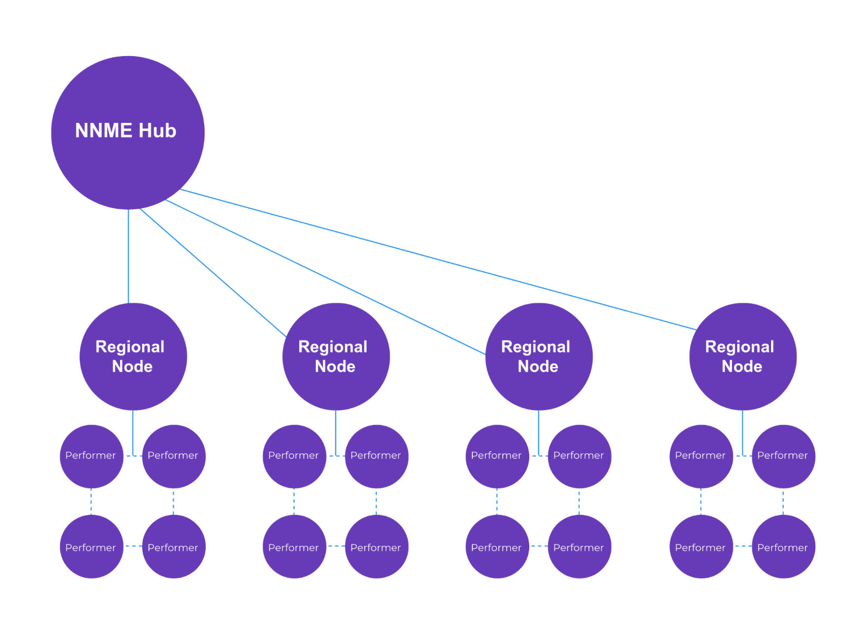
Connecting National Strategy to Regional Action
The U.S. faces a projected need for 170,000 additional semiconductor workers by 2030, but scaling the talent pipeline is constrained by systemic challenges. These include misalignment between education and industry needs, inequitable access to resources, chronic underinvestment in education and training activities and facilities, outdated workforce development capabilities, fragmented training ecosystems, and limited awareness of semiconductor career opportunities.
Regional Nodes change this.
Regional Nodes will serve as coordinating hubs that align regional stakeholders to develop and deliver industry-aligned education and training, expand equitable access, and strengthen pathways into high-demand semiconductor careers. Nodes will modernize and upgrade education and training activities and facilities, integrate emerging technologies, connect education providers with employers, scale work-based learning, build regional and community awareness, and align federal, state, and industry initiatives as part of a nationally coordinated strategy led by the NNME Hub.
Performers may include industry, colleges and universities, workforce development organizations, K-12 Schools, EDO's, etc.

Slide 14


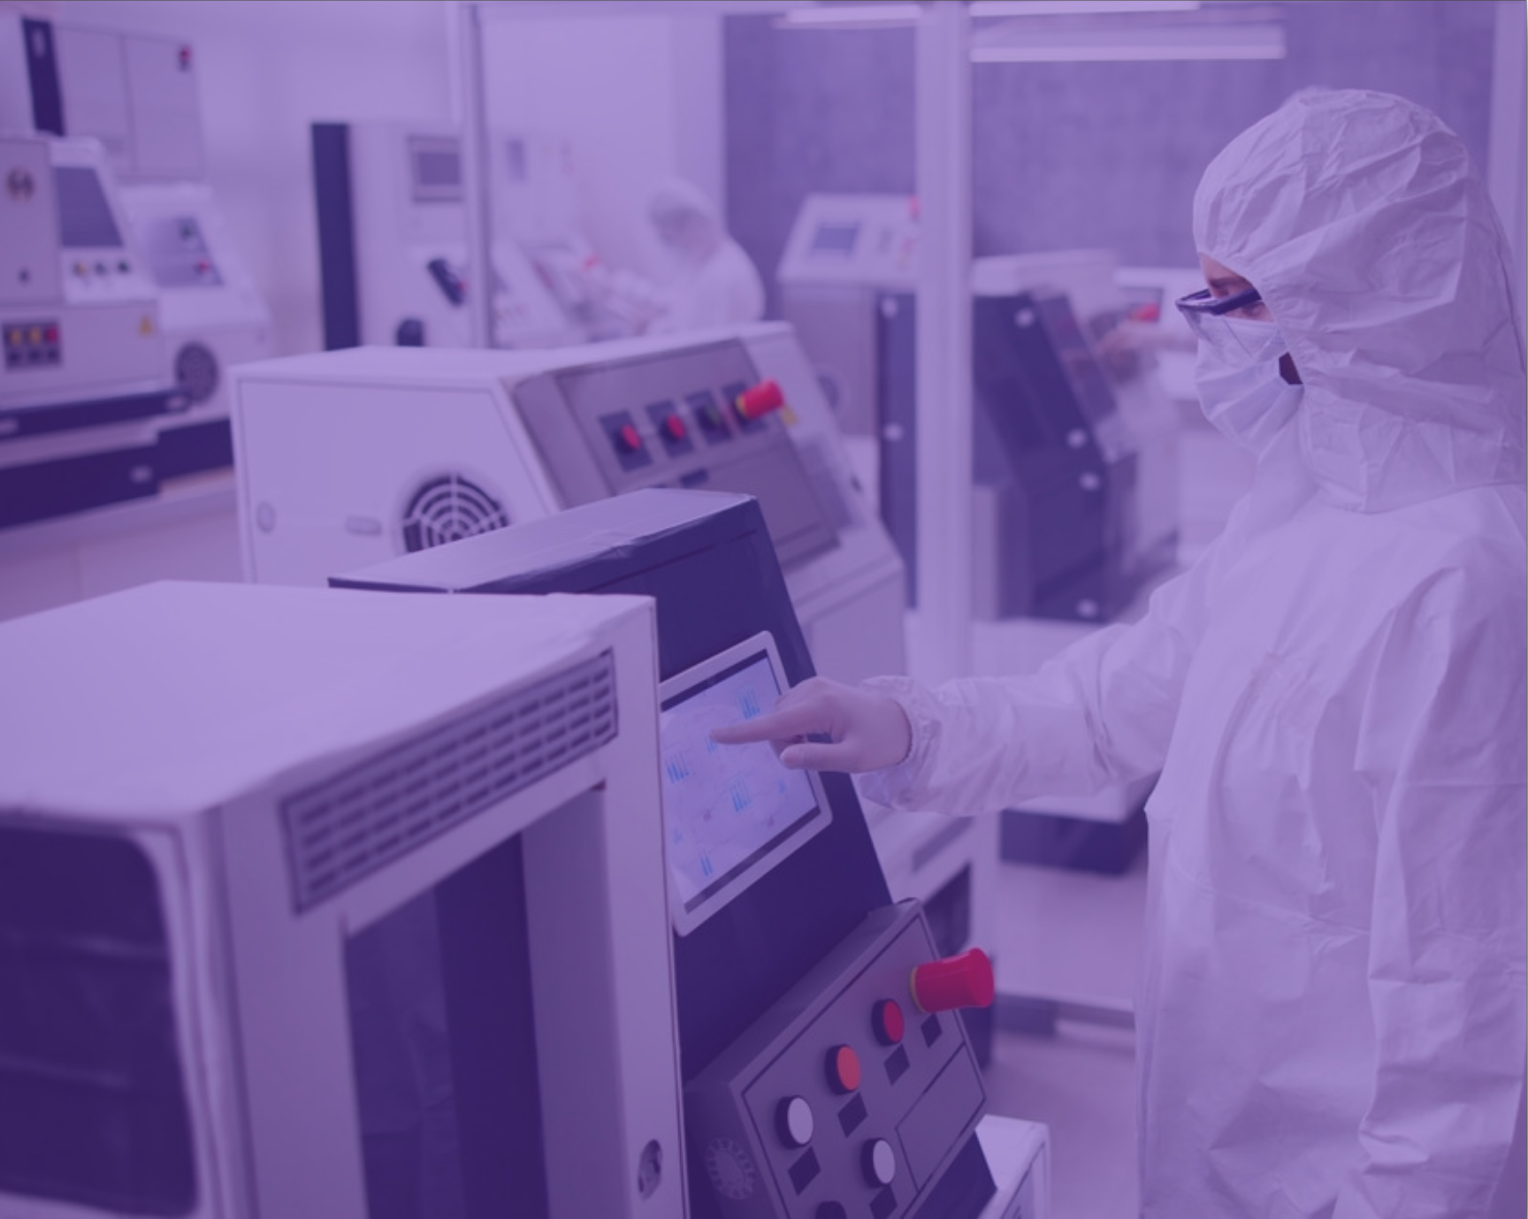
Status: In Progress
NNME Landscape Analysis
The National Landscape Analysis, developed with analytical support from McKinsey, will deliver a clear, data-driven picture of the U.S. semiconductor talent pipeline—mapping existing programs, identifying gaps and strengths, assessing regional readiness, and establishing baseline metrics for workforce demand and capacity.
This work is foundational to the NNME. It will inform decisions about Regional Nodes, curriculum modernization, and partnership investments, and serve as the basis for a living analytical model that continuously tracks workforce supply and demand at both regional and national levels—ensuring alignment with industry needs and focus on long-term impact.

Slide 15


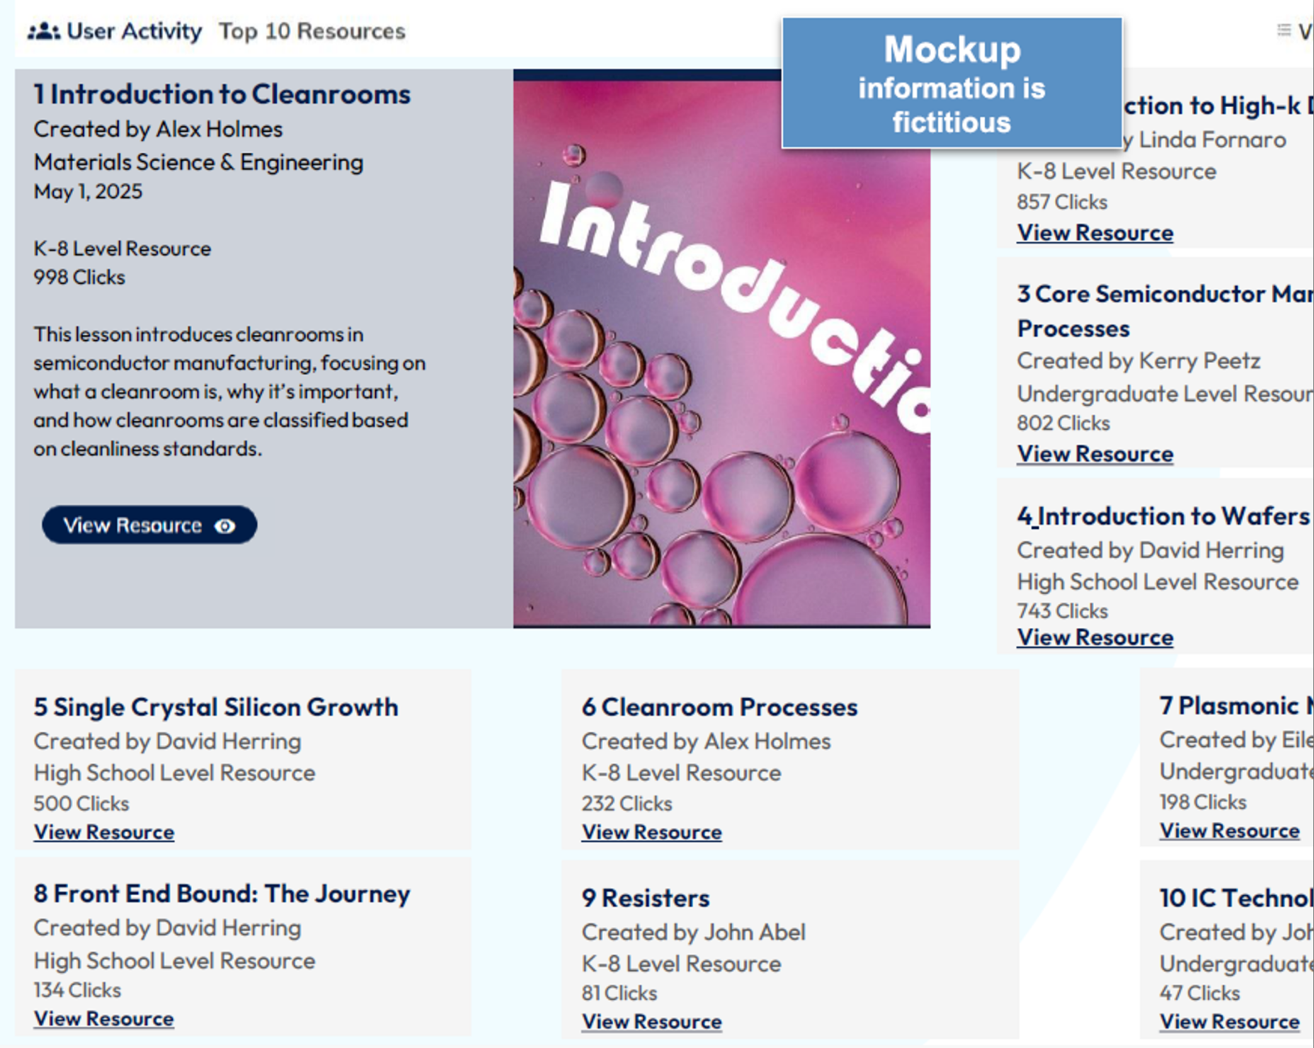

Status: In Progress
SemiSphere™ will transform semiconductor training with fresh, industry-aligned content designed to keep pace with rapid technological change. The platform will empower educators with modern modules and clear pathways that reflect real workforce needs.
SemiSphere™ will serve as the national first-stop portal where K–12 teachers, community colleges, and universities can access high-quality resources, exchange proven approaches to curriculum design, instruction, and assessment, and connect directly with the broader microelectronics ecosystem.

Slide 16


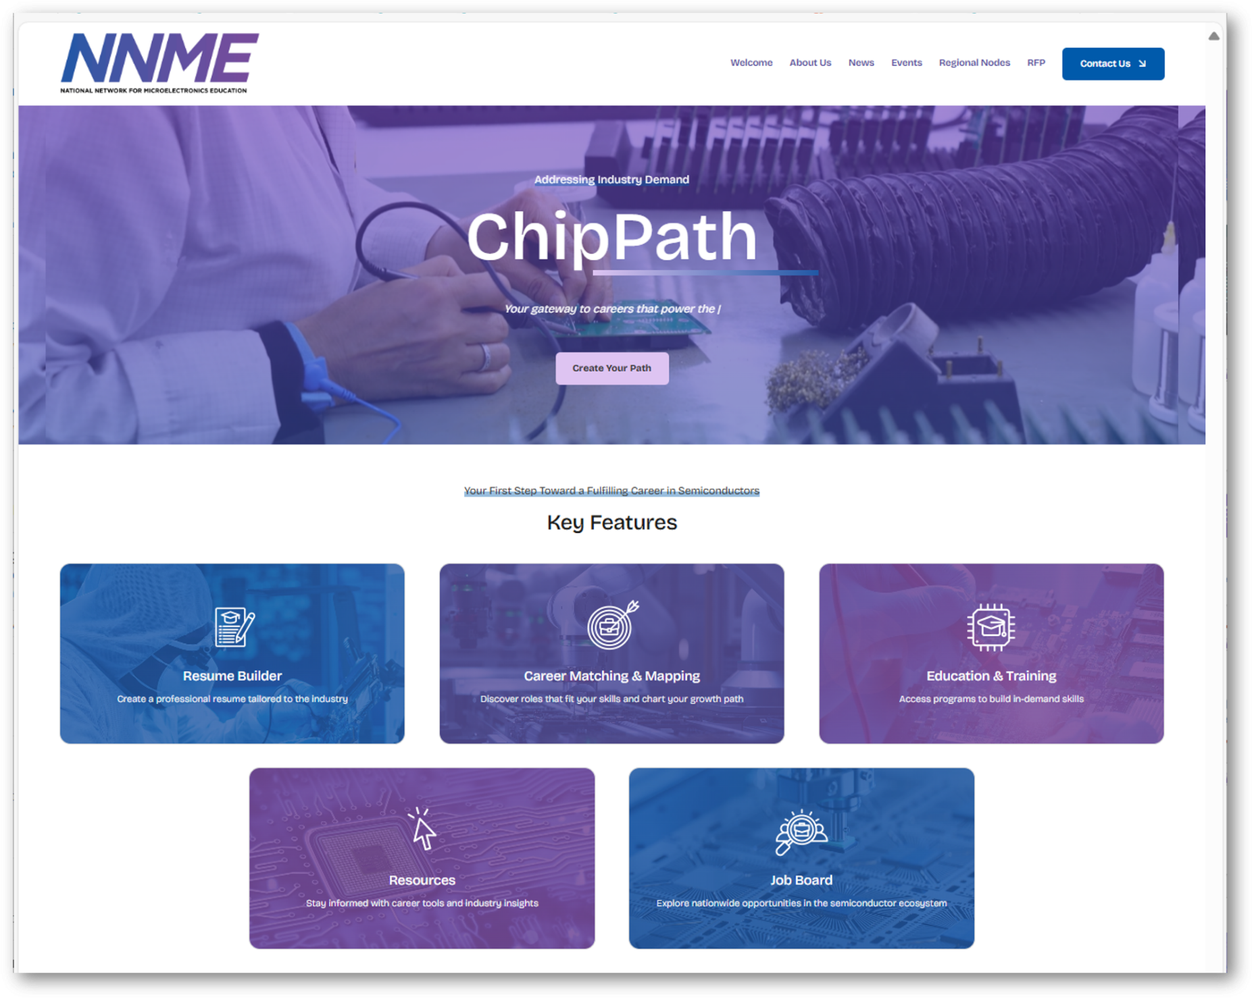

Status: Launched
ChipPath™ is the NNME’s new AI-enabled career platform and the central gateway into U.S. semiconductor careers. With over 130,000 live job openings sourced directly from SEMI member companies' career sites, it offers one of the most comprehensive views of opportunities across the microelectronics supply chain.
ChipPath™ offers AI-driven tools for career exploration, resume building, and training pathways—connecting talent to real opportunities and supporting entry into high-demand semiconductor roles.

Slide 17


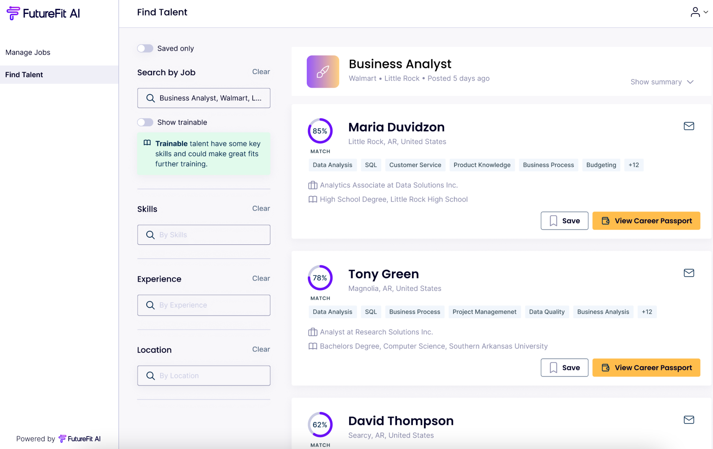


Coming in 2026: Employer Portal
Seamlessly Upload Jobs
Recruiters can post jobs or have jobs scraped in directly, with tools and automations to help them save time
Automated Candidate Matching
Get matched with candidates based on skills-based AI technology and reduce time to hire
Subtitle
Access Untapped Talent
Body Text
Identify “trainable” candidates to fill talent gaps with early-career talent and those with transferable skills

Slide 18

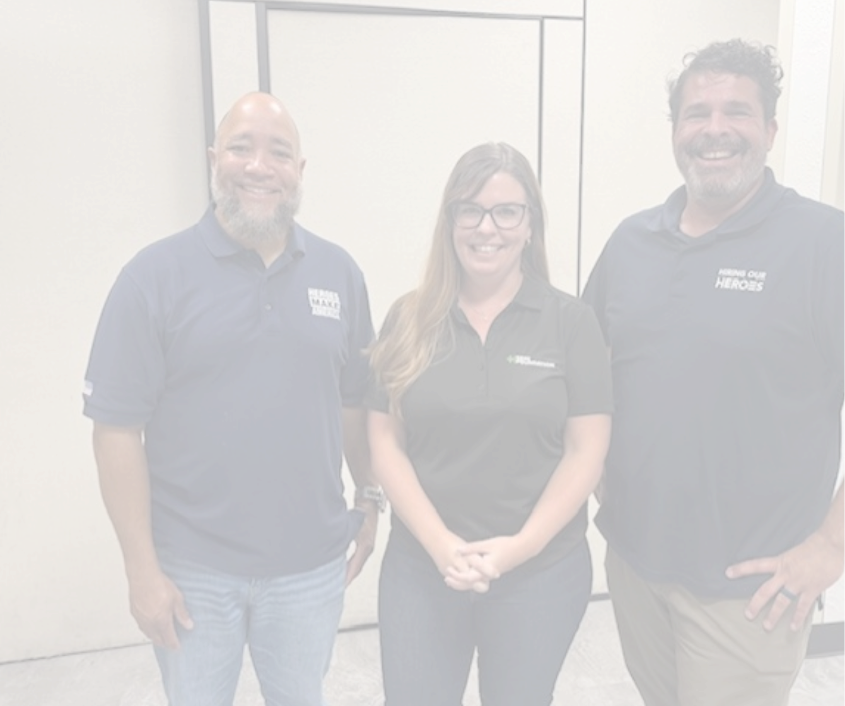

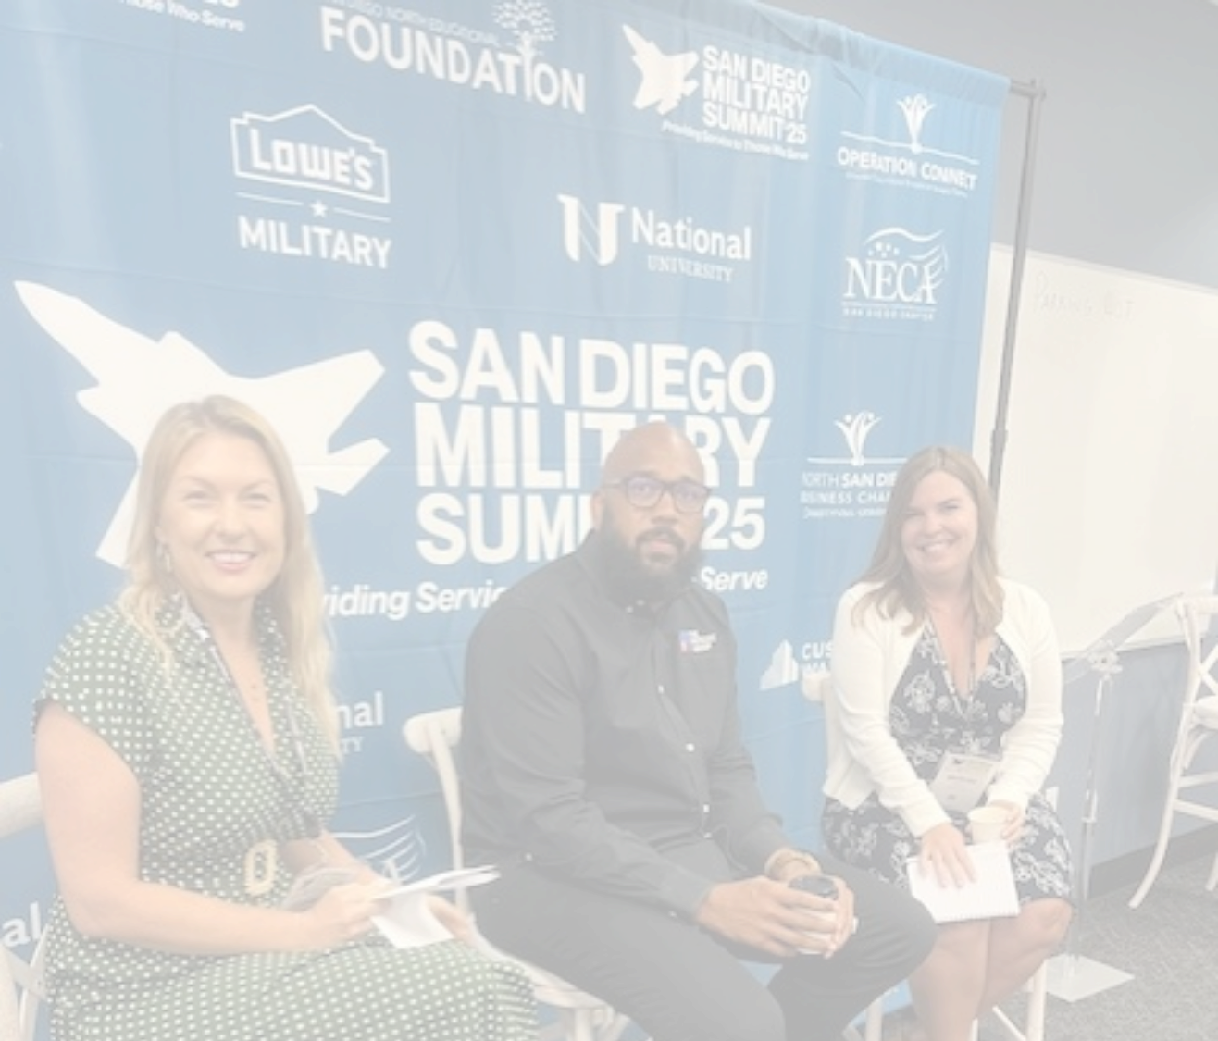


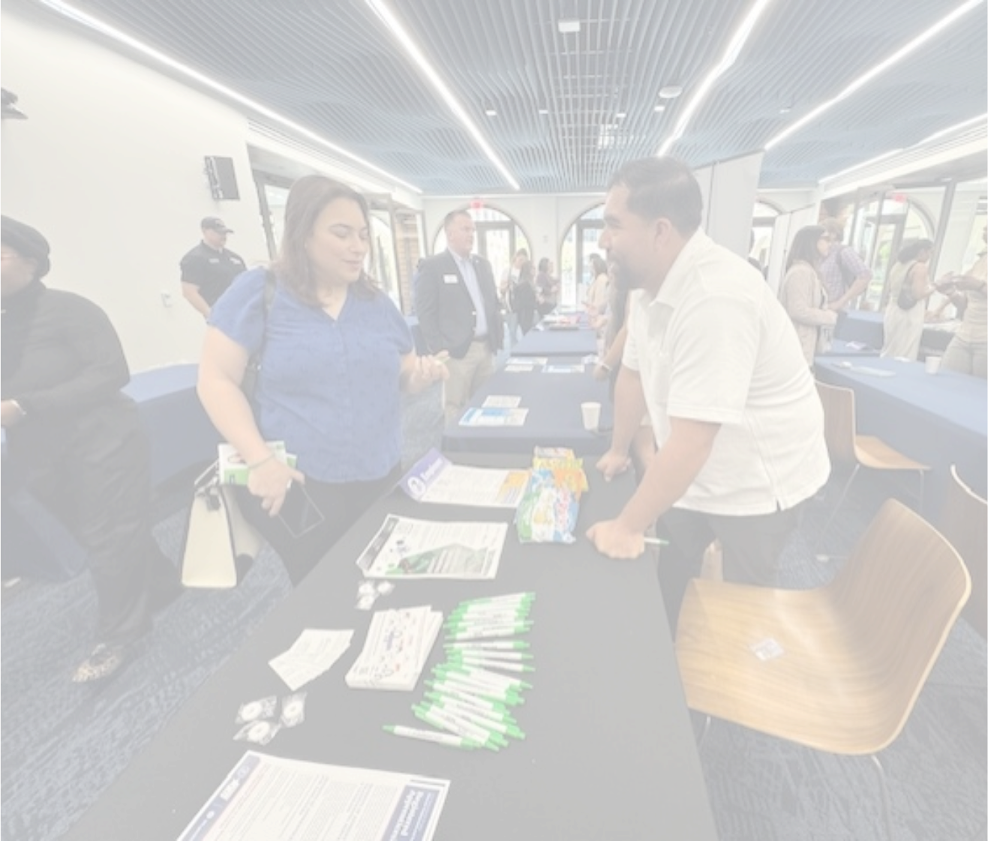

VetWorks
    55,000+ veterans and service members reached in 2025 through partnerships with DOL VETS, Hiring Our Heroes, and Heroes MAKE America.
    Recognized as a high-growth industry for transitioning military, with direct links to SEMI career pathways in official transition handbooks.
    30+ partner engagement events and 20+ employer participants this year, deepening industry connections.
    2025 focus: strengthening strategic partnerships to convert awareness into career opportunities for veterans nationwide.

Slide 19
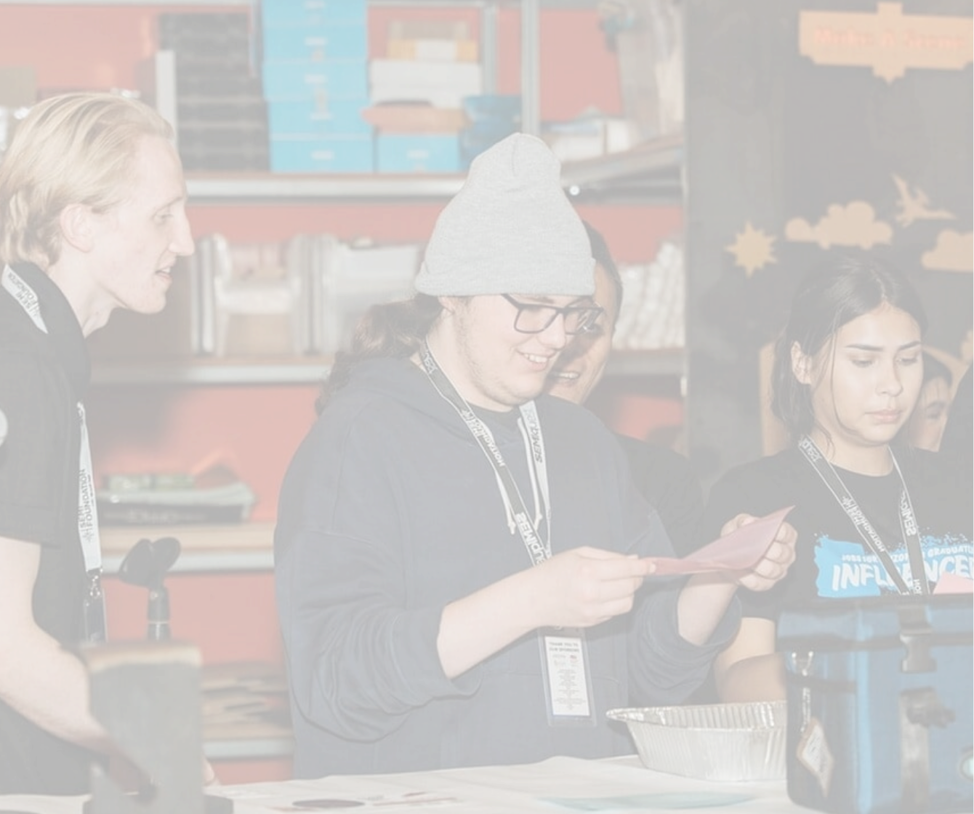

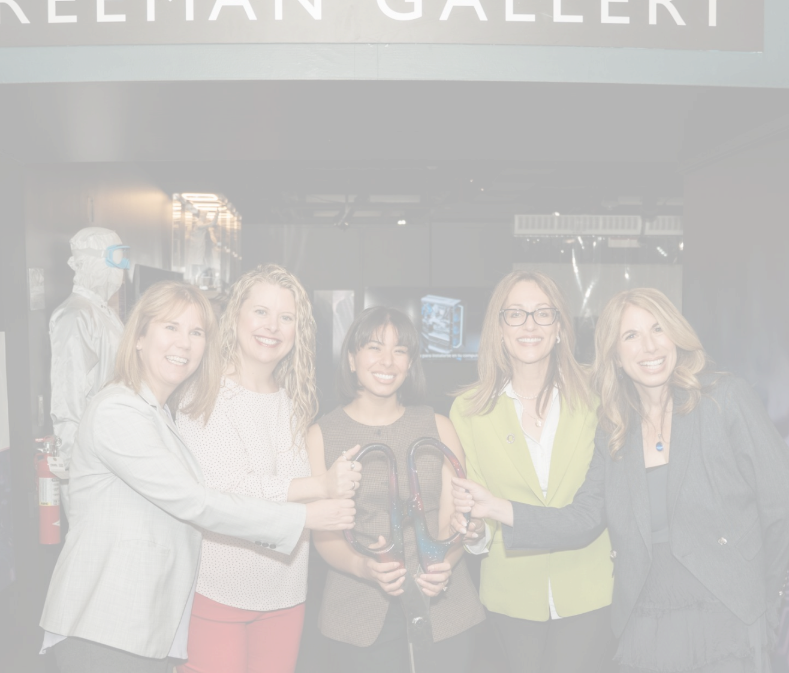

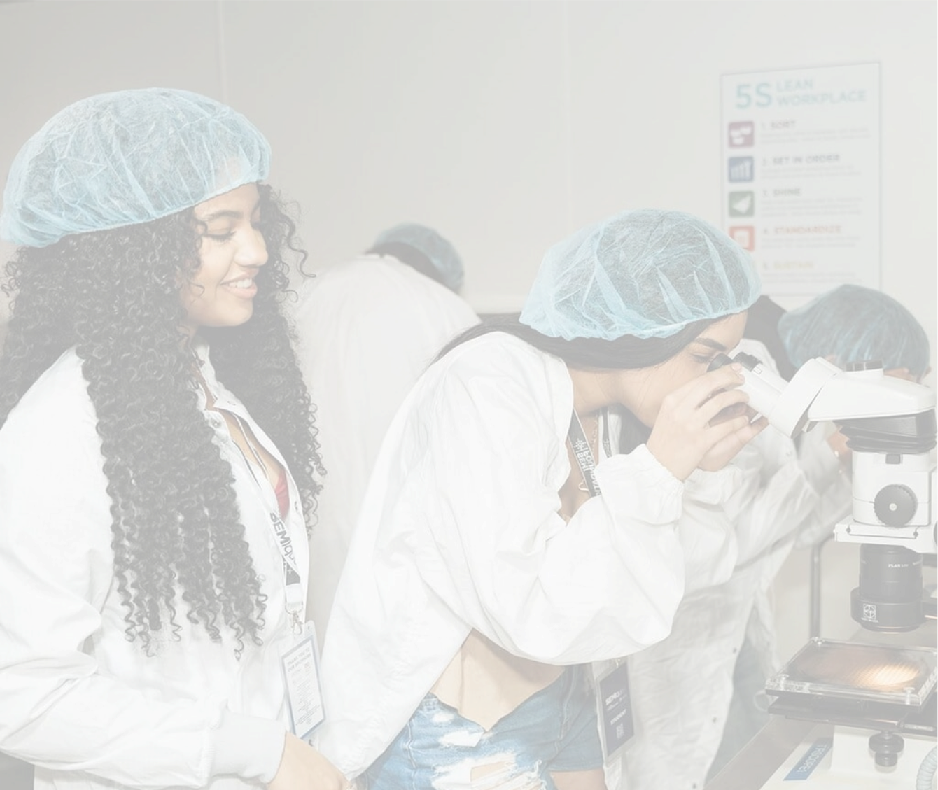

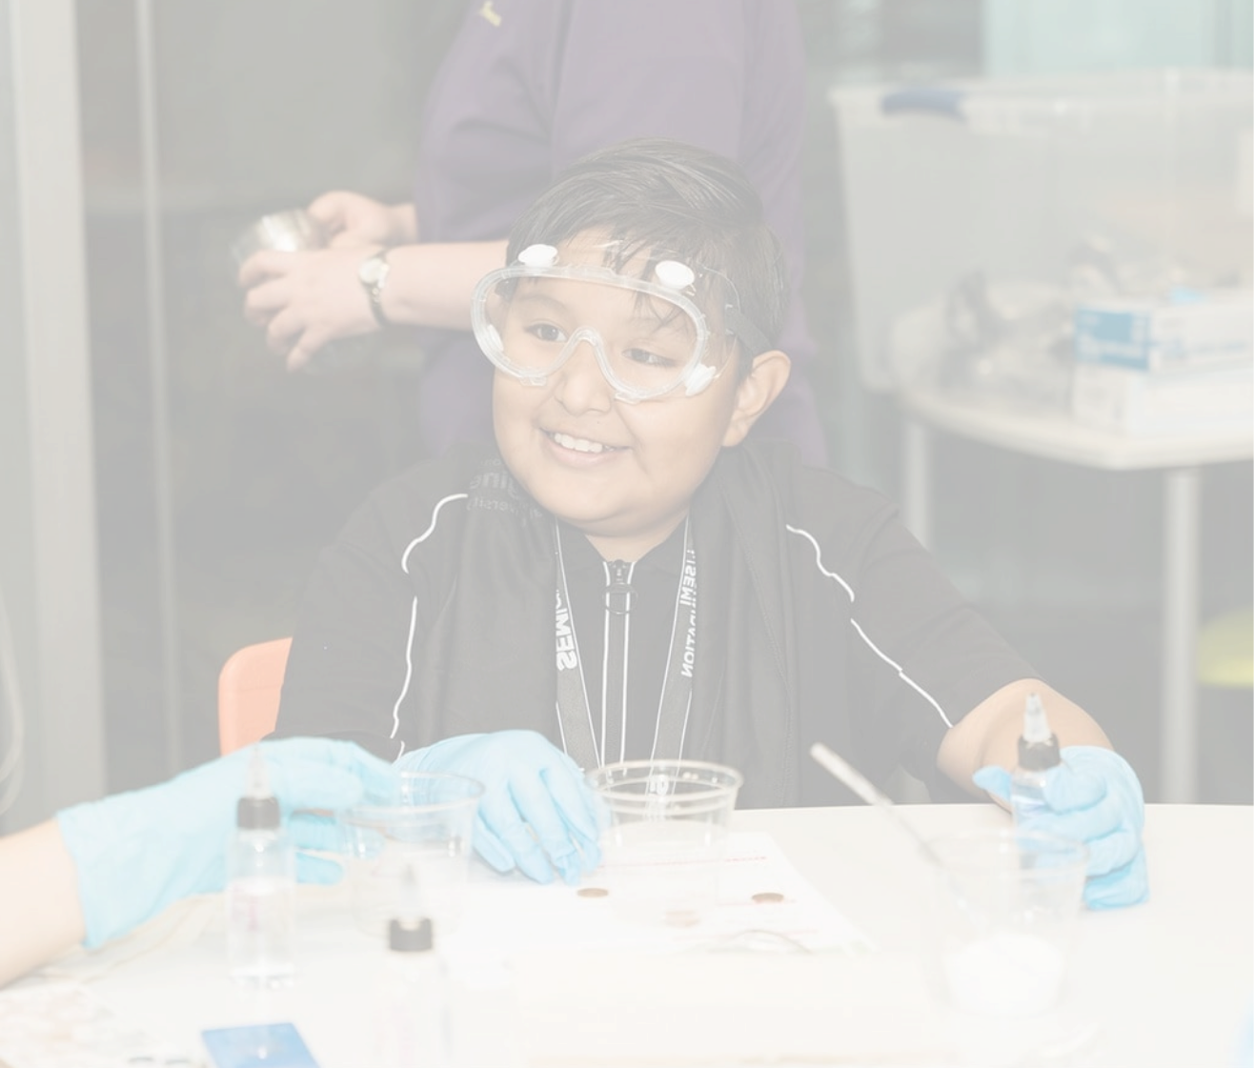
Immersive Semiconductor Experience
Interactive Exhibit at the Arizona Science Center
47,300+ visitors and counting — including 160+ teachers and nearly 1,000 students, inspiring educators who reach 45,000+ learners statewide.
    Earned major visibility through local Arizona coverage and international media in Asia and India.
    Laying the groundwork to sustain and scale SEMIquest across Arizona and new communities nationwide.

Slide 20


SEMI Certificates
Progress
    45 companies, 16 states engaged to define competencies.
    SMEs from 12 colleges/universities developing assessments.
    Pilot underway:
      46 participants completed multiple-choice (Part One) pilot.
      Hands-on pilot (Part Two) launches March 2026.
Next Steps
    Validate pilot data and finalize assessments.
    Launch regionally in Spring 2026, with a measured 30/60/90-day review cycle.
    Continue partnering with employers to integrate certification into hiring.
Call to Action
    Nominate new hires or grads to join the pilot.
    Champion SEMI Certificates in your company’s hiring practices.
Notes:
Addressing a key challenge identified by industry: lack of standardized semiconductor learning outcomes across regions and educational systems, resulting in fragmented training, onboarding delays, and significant learning gaps for new hires
Certification offers solutions x3:
Educators hear directly from employers about industry needs and trends, leads to curriculum modernization and alignment
Employers gain the opportunity to quickly identify qualified candidates
Job-seekers can credibly communicate skills and knowledge regardless of previous experience or education
SEMI Foundation is developing a two-part assessment to indicate a jobseeker’s readiness to succeed on day one as an Equipment Maintenance Technician, but also applies to other roles (Process Tech, some Field Service Engineer roles, and other entry level technical roles)
Learners that successfully complete both parts receive a portable, accredited, industry-aligned certification

Slide 21

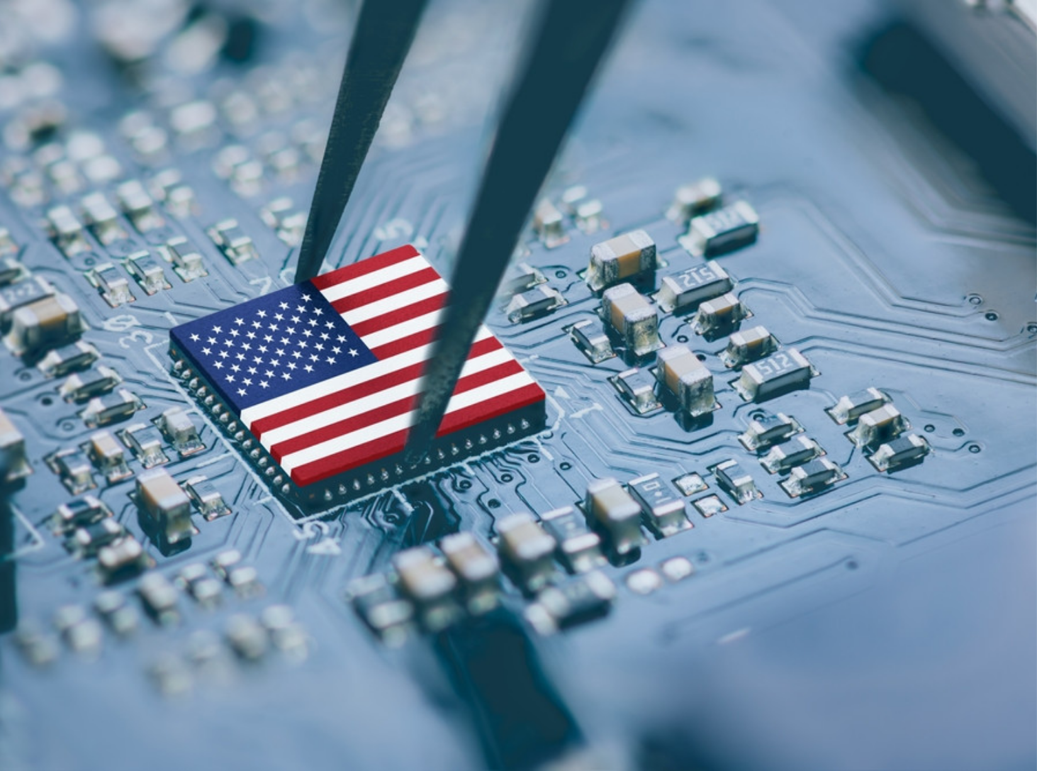
SEMI Foundation Named USDOL National Group Sponsor
The SEMI Foundation has received designation as a National Group Sponsor from the United States Department of Labor, a significant federal recognition that positions SEMI at the center of the nation’s workforce strategy for advanced manufacturing.
This designation directly aligns with the Administration’s America’s Talent and Workforce Strategy, which elevates Registered Apprenticeships as a core tool for building a resilient, competitive workforce in strategic industries like semiconductors.
Why this is exciting
The SEMI Foundation can now design, register, and scale apprenticeships nationally, working directly with member companies, removing friction, accelerating adoption, and strengthening the industry’s talent pipeline.
The U.S. will need more than 170,000 additional semiconductor workers by 2030, making workforce development a priority.

Slide 22

Through this model, the Foundation will:
    Reduce administrative and regulatory barriers by serving as the single point of contact with USDOL and managing registration, reporting, and compliance on behalf of members.
    Standardize high-quality, industry-aligned frameworks that reflect real semiconductor roles and skills while remaining adaptable to employer-specific needs.
    Enable faster deployment across states and regions through nationally approved standards that can be implemented without rebuilding programs state-by-state.
    Ensure federal quality standards without limiting employer control by maintaining compliance, reporting and oversight while employers retain authority over hiring, training, and workforce outcomes.
A Strategic Advantage for SEMI Member Companies
SEMI members gain speed, consistency, and scale, without building complex internal compliance infrastructure

Slide 23

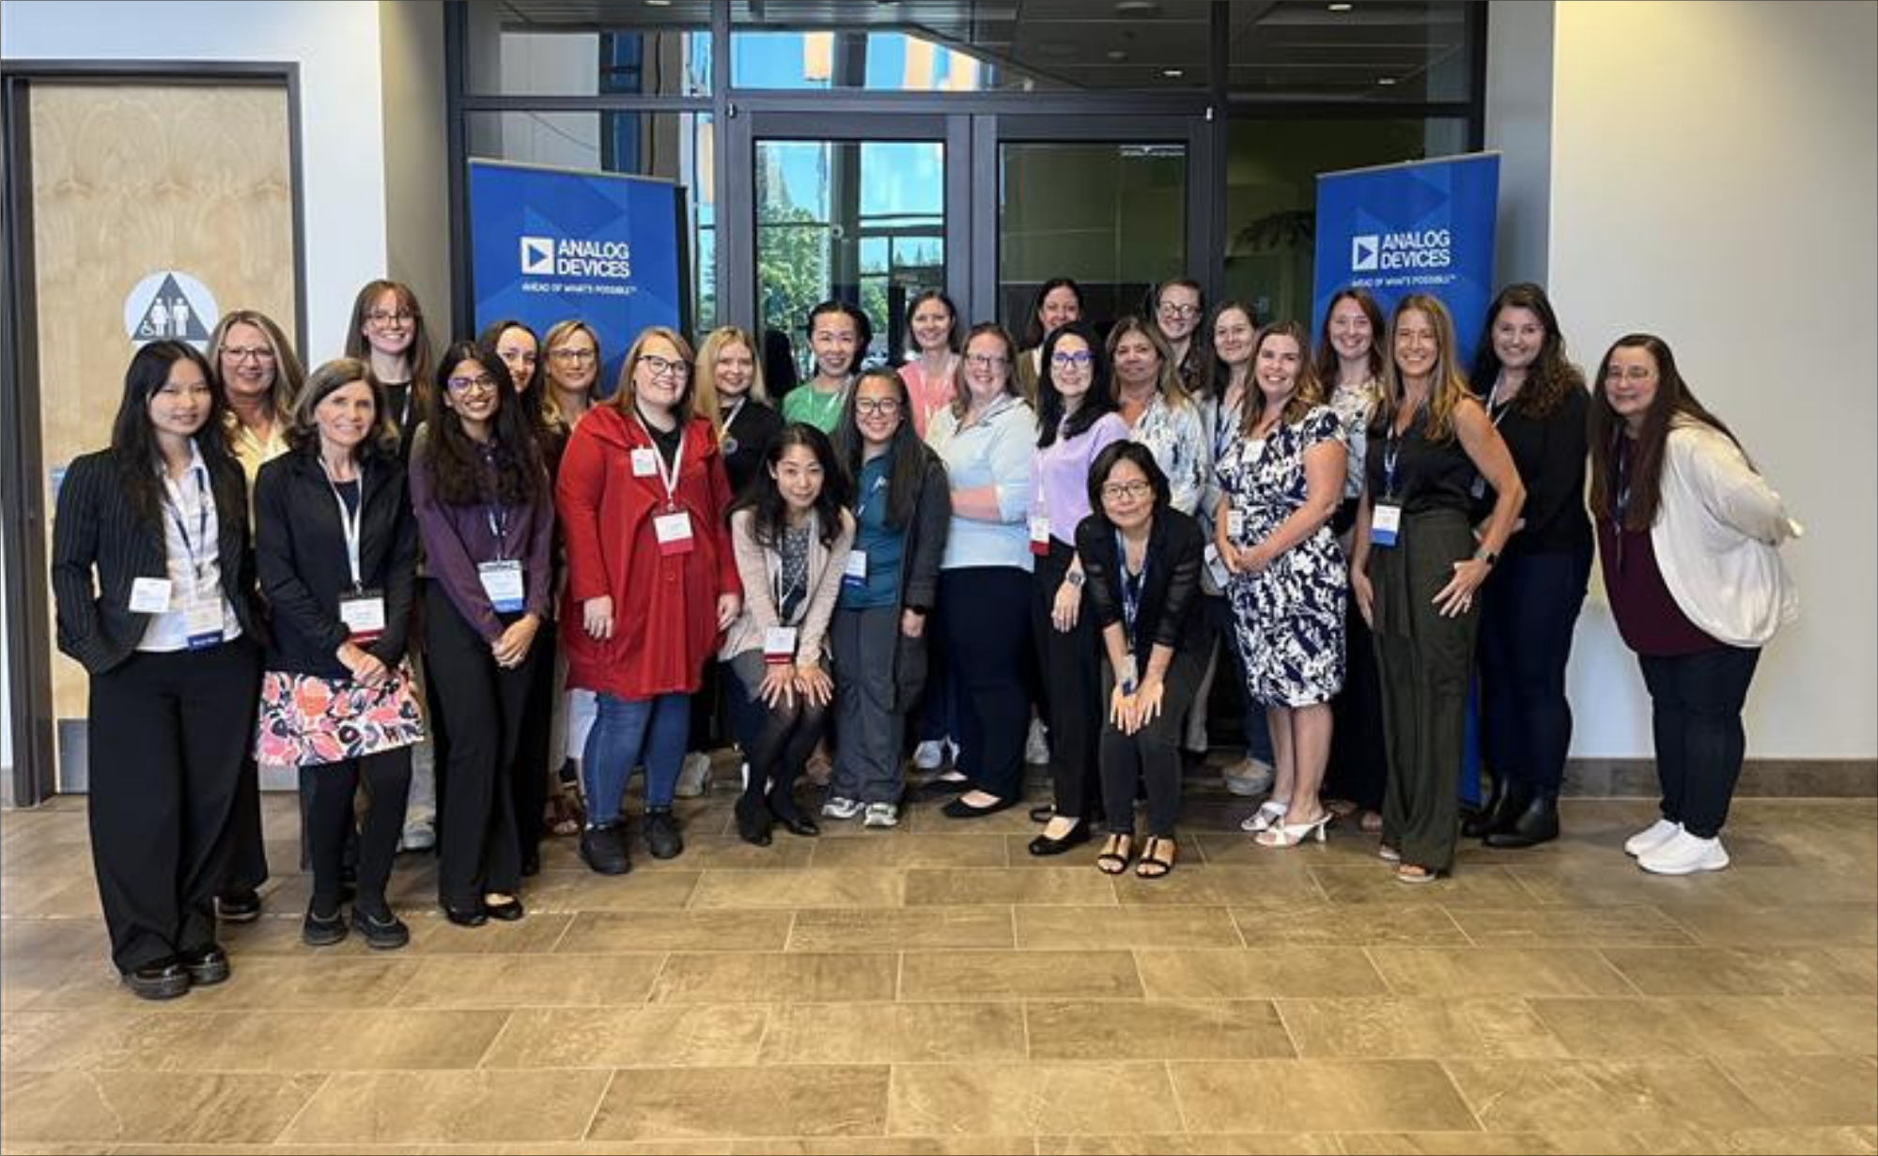
Women of the Fab Owners Alliance (FOA)
The Fab Owners Alliance has long had low female representation, particularly at meetings—as low as 3%. The Women of the FOA was created to change that.
Our Mission
To support women in reaching their full potential while helping attract, retain, and uplift women in the semiconductor industry. To learn more, contact Christie Baker at cbaker@semi.org.

Slide 24








925% increase
WFOA Survey
Has the WFOA had an impact on you, your approach to your work, or your
company?
The connection with others in WFOA has helped me be more confident, which helps in my daily interactions.
It creates a powerful space for support, shared insight, and collective confidence that helps ALL women
The WFOA has redefined my approach to operational excellence. It has shown me that the next leap in fab performance won't just come from hardware, but from modernizing culture.
I found it to be morale-building for me. It is pretty horrible to be outnumbered 15:1 at work for over 3 decades. Community is a wonderful thing to
build!
It opened up some conversations with some WFOA member on how to improve position descriptions. These were taken back internally

Slide 25






Partner on Workforce Programs
Shape talent pipelines through internships, apprenticeships, and curriculum alignment.
Join Our Networks
Collaborate with peers, share best practices, and access talent pools – particularly through the NNME
Sponsor Awareness + Education Initiatives
From K-12 programs to SEMIquest —make semiconductors visible and exciting.
Support Access Programs
Champion and join initiatives like Women in Semiconductors and VetWorks
Invest in the Future
Fund internships and scholarships, resource workforce programs, build stronger workplace cultures
Powering Progress Together.
Ways to get involved

Slide 26


The workforce challenge is the opportunity of our time. Let's collaborate!
Michelle Williams
Executive Director, SEMI Foundation
mwilliams@semi.org

