Slide 1

Spectrum and RFI Sensing using Digital Multi-Beam Circular Apertures
S. Rathnayaka, B. Thevathasan, U. Kumarasiri, S. Sivasankar,
A. Madanayake, M. Pulugurtha
Electrical and Computer Engineering
Florida International University

Slide 2
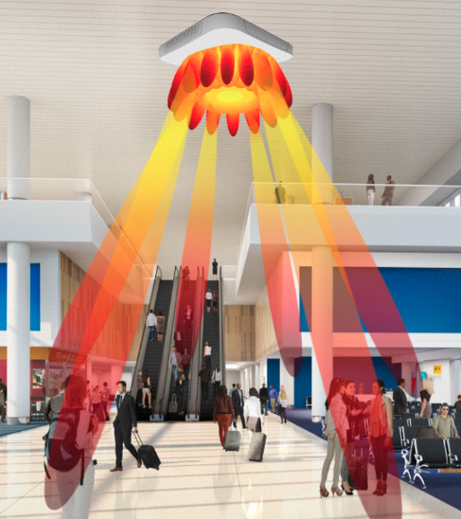
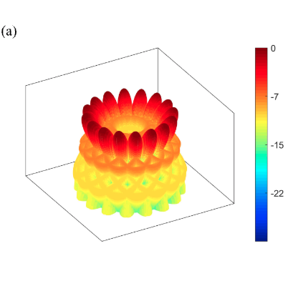
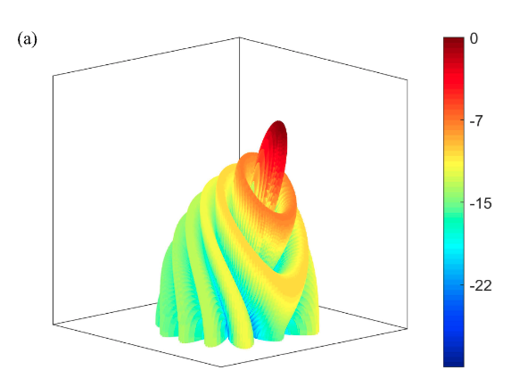
Introduction
360° RF spectrum monitoring is essential for situational awareness.
Requires information on direction of arrival, frequency occupancy, modulation, power, and bandwidth.
Digital multibeam beamforming provides simultaneous multi directional sensing.
Uniform Circular Arrays are widely used in Wi-Fi, radar, and 5G systems.
V. Ariyarathna and A. Madanayake, “Circular Array N-Beam Digital Beamformer Having Low Arithmetic Complexity: 16 Simultaneous 100 MHz Beams at 2.4 GHz,” IEEE Transactions on Radar Systems, vol. 1, pp. 318–324, 2023.

Slide 3
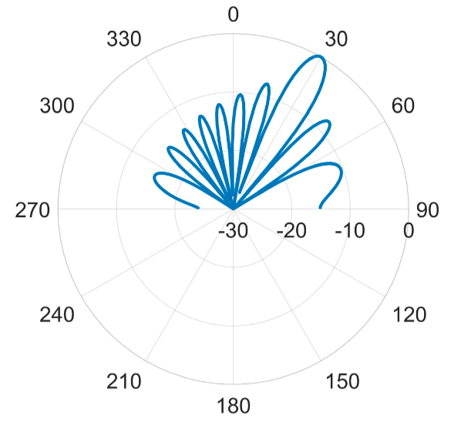
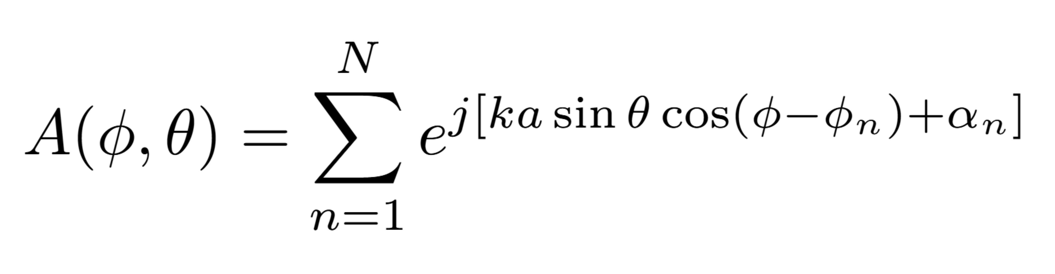
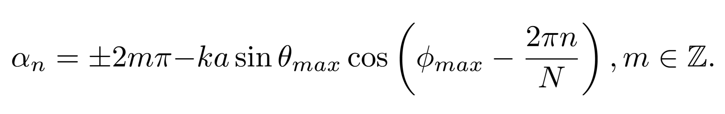
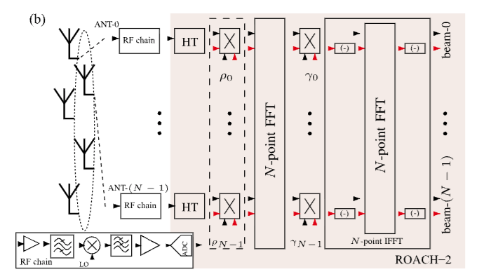
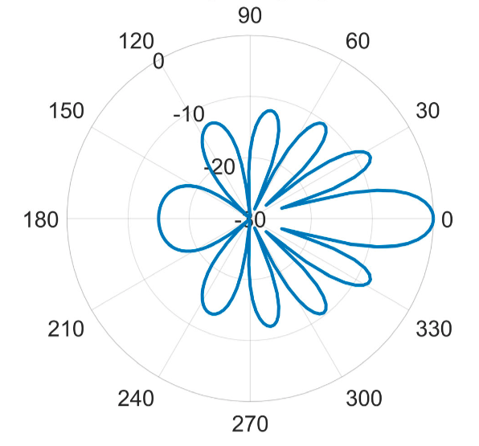
System Model
16 isotropic antenna elements arranged in Uniform Circular phased array.
Each beam formed using weighted array factor and circulant matrix.
Beams can be steered in 3D (both azimuth and elevation planes)
Digital backend computes 16 simultaneous beams using ADFT (Approximate-DFT).
Provides 100 MHz bandwidth per beam.
Heterodyne analog front-end with LNAs and bandpass filters.
Down-converted signals digitized using ADC 16×250 8 at 200 MHz.
Calibration compensates gain and phase mismatches.
FPGA backend implements ADFT-based multibeam computation.
V. Ariyarathna and A. Madanayake, “Circular Array N-Beam Digital Beamformer Having Low Arithmetic Complexity: 16 Simultaneous 100 MHz Beams at 2.4 GHz,” IEEE Transactions on Radar Systems, vol. 1, pp. 318–324, 2023.

Slide 4
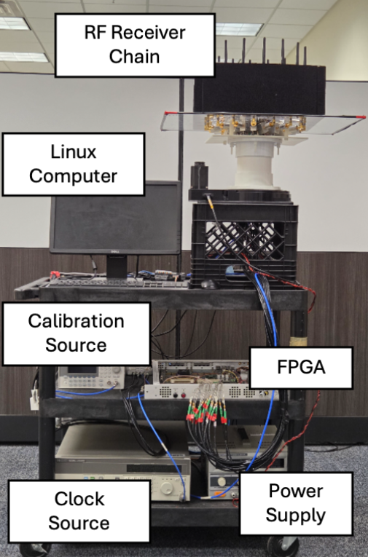
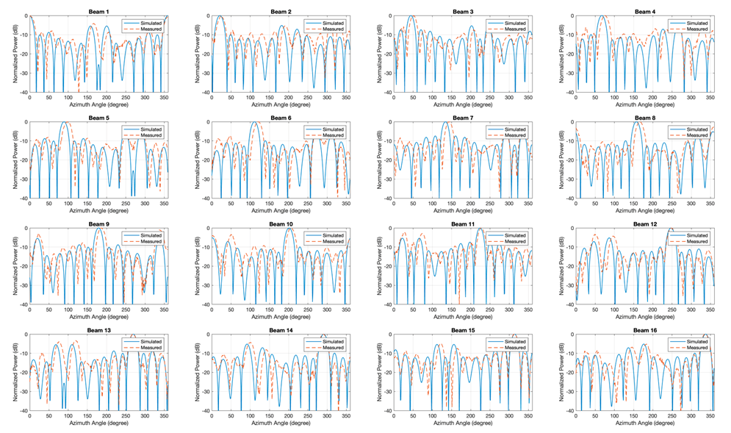
Experimental Setup and Results

