Slide 1


FLORIDA SEMICONDUCTOR SUMMIT 2026
PROGRESS THROUGH PARTNERSHIP
Lessons Across Industry, Applied Innovation, & Workforce
Samantha Miles | Vertex, Applied Innovation Hub at Florida Tech

Slide 2
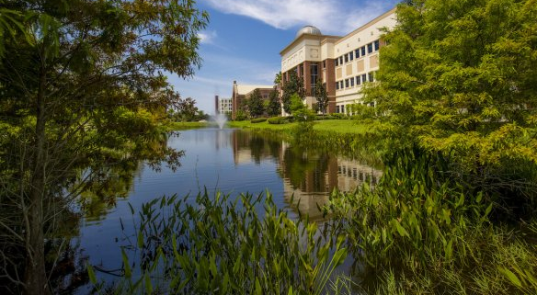
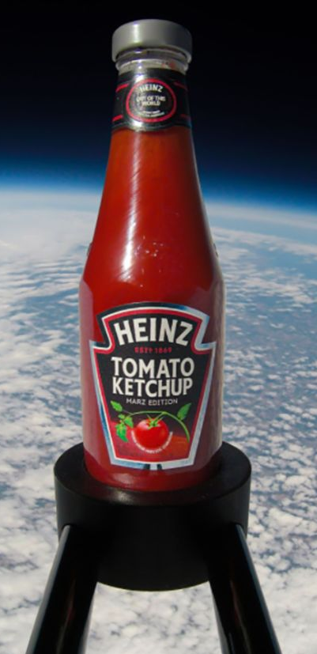
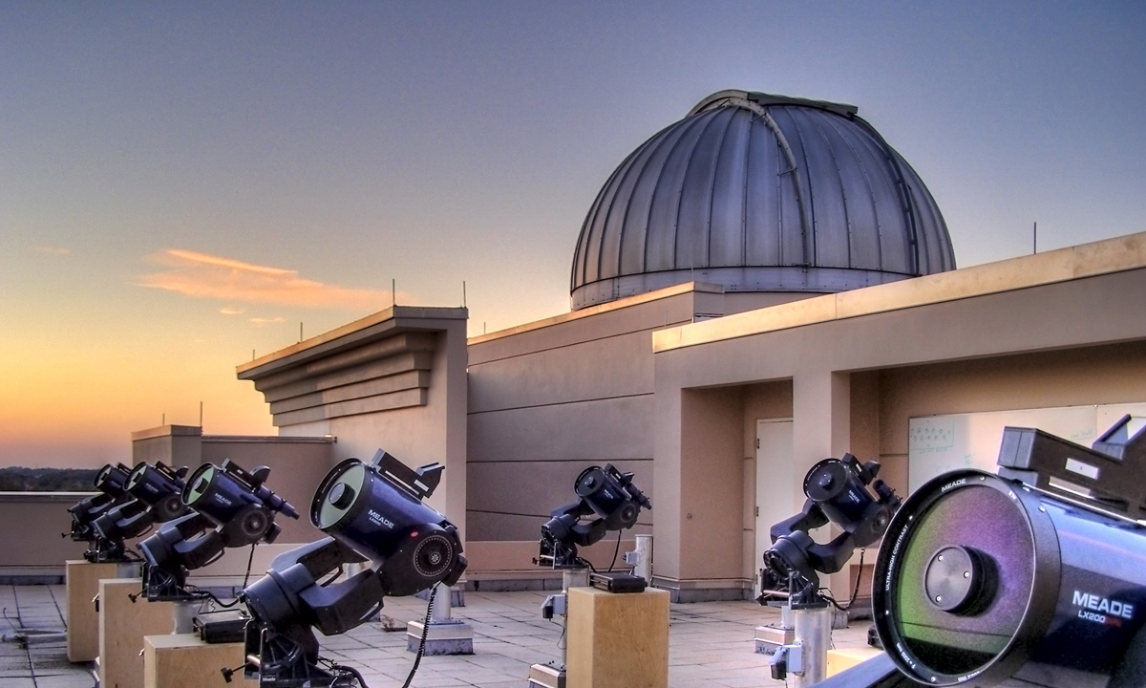

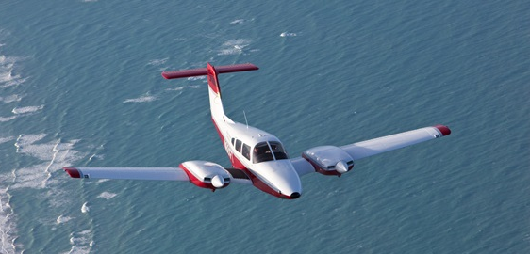
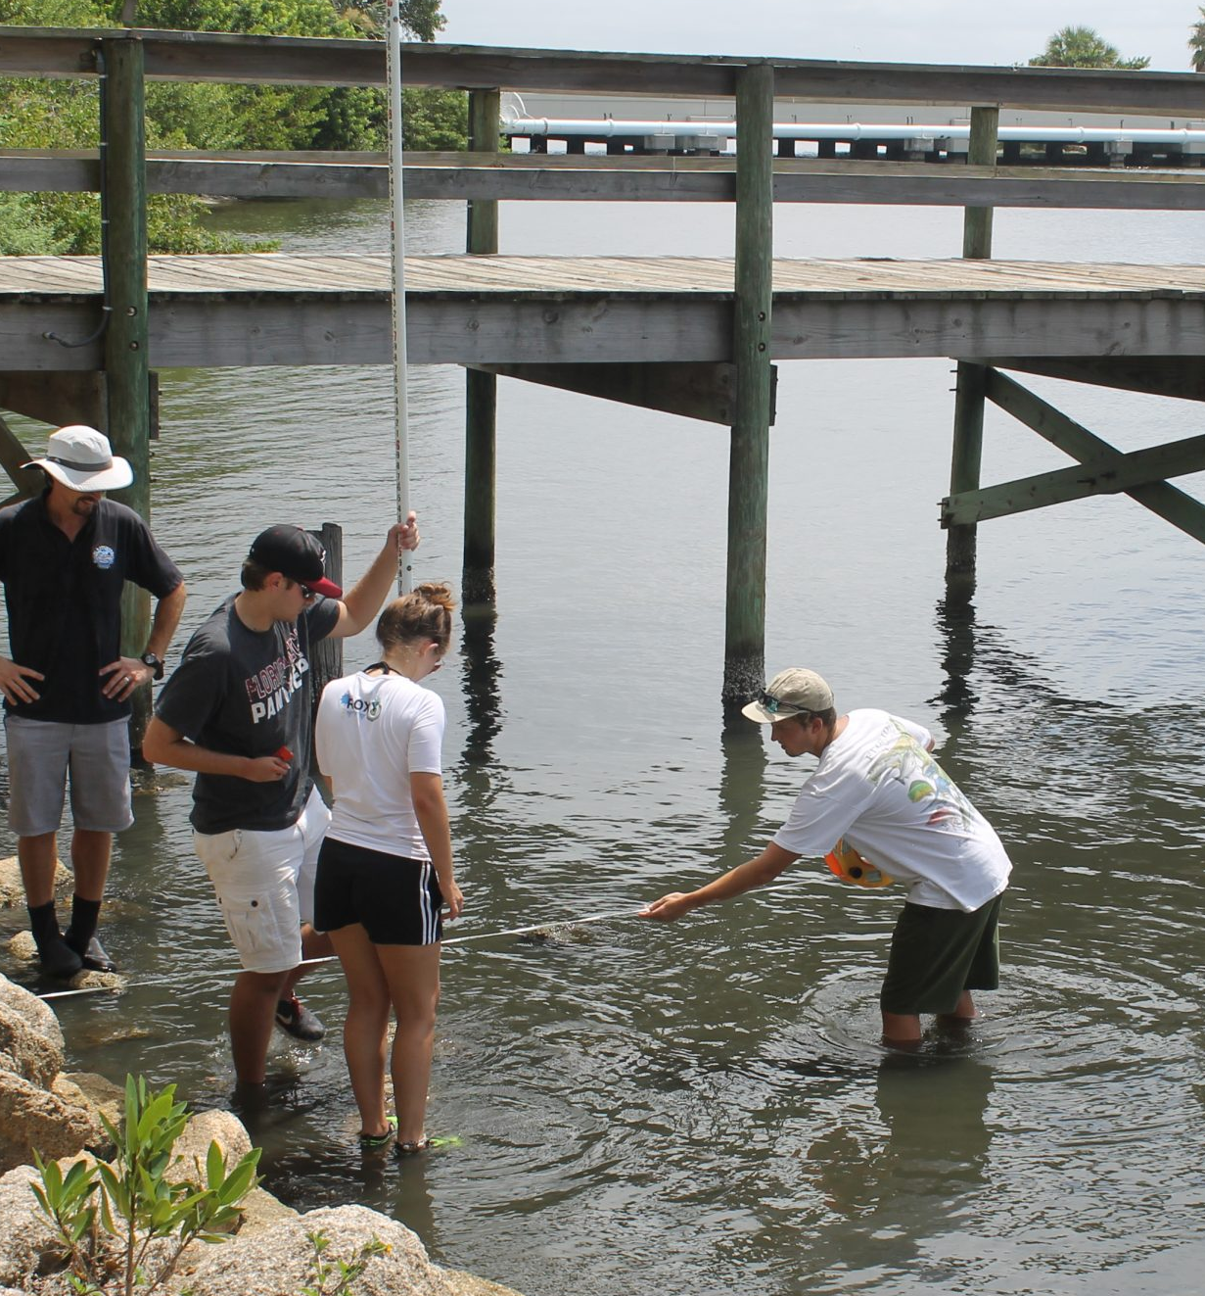
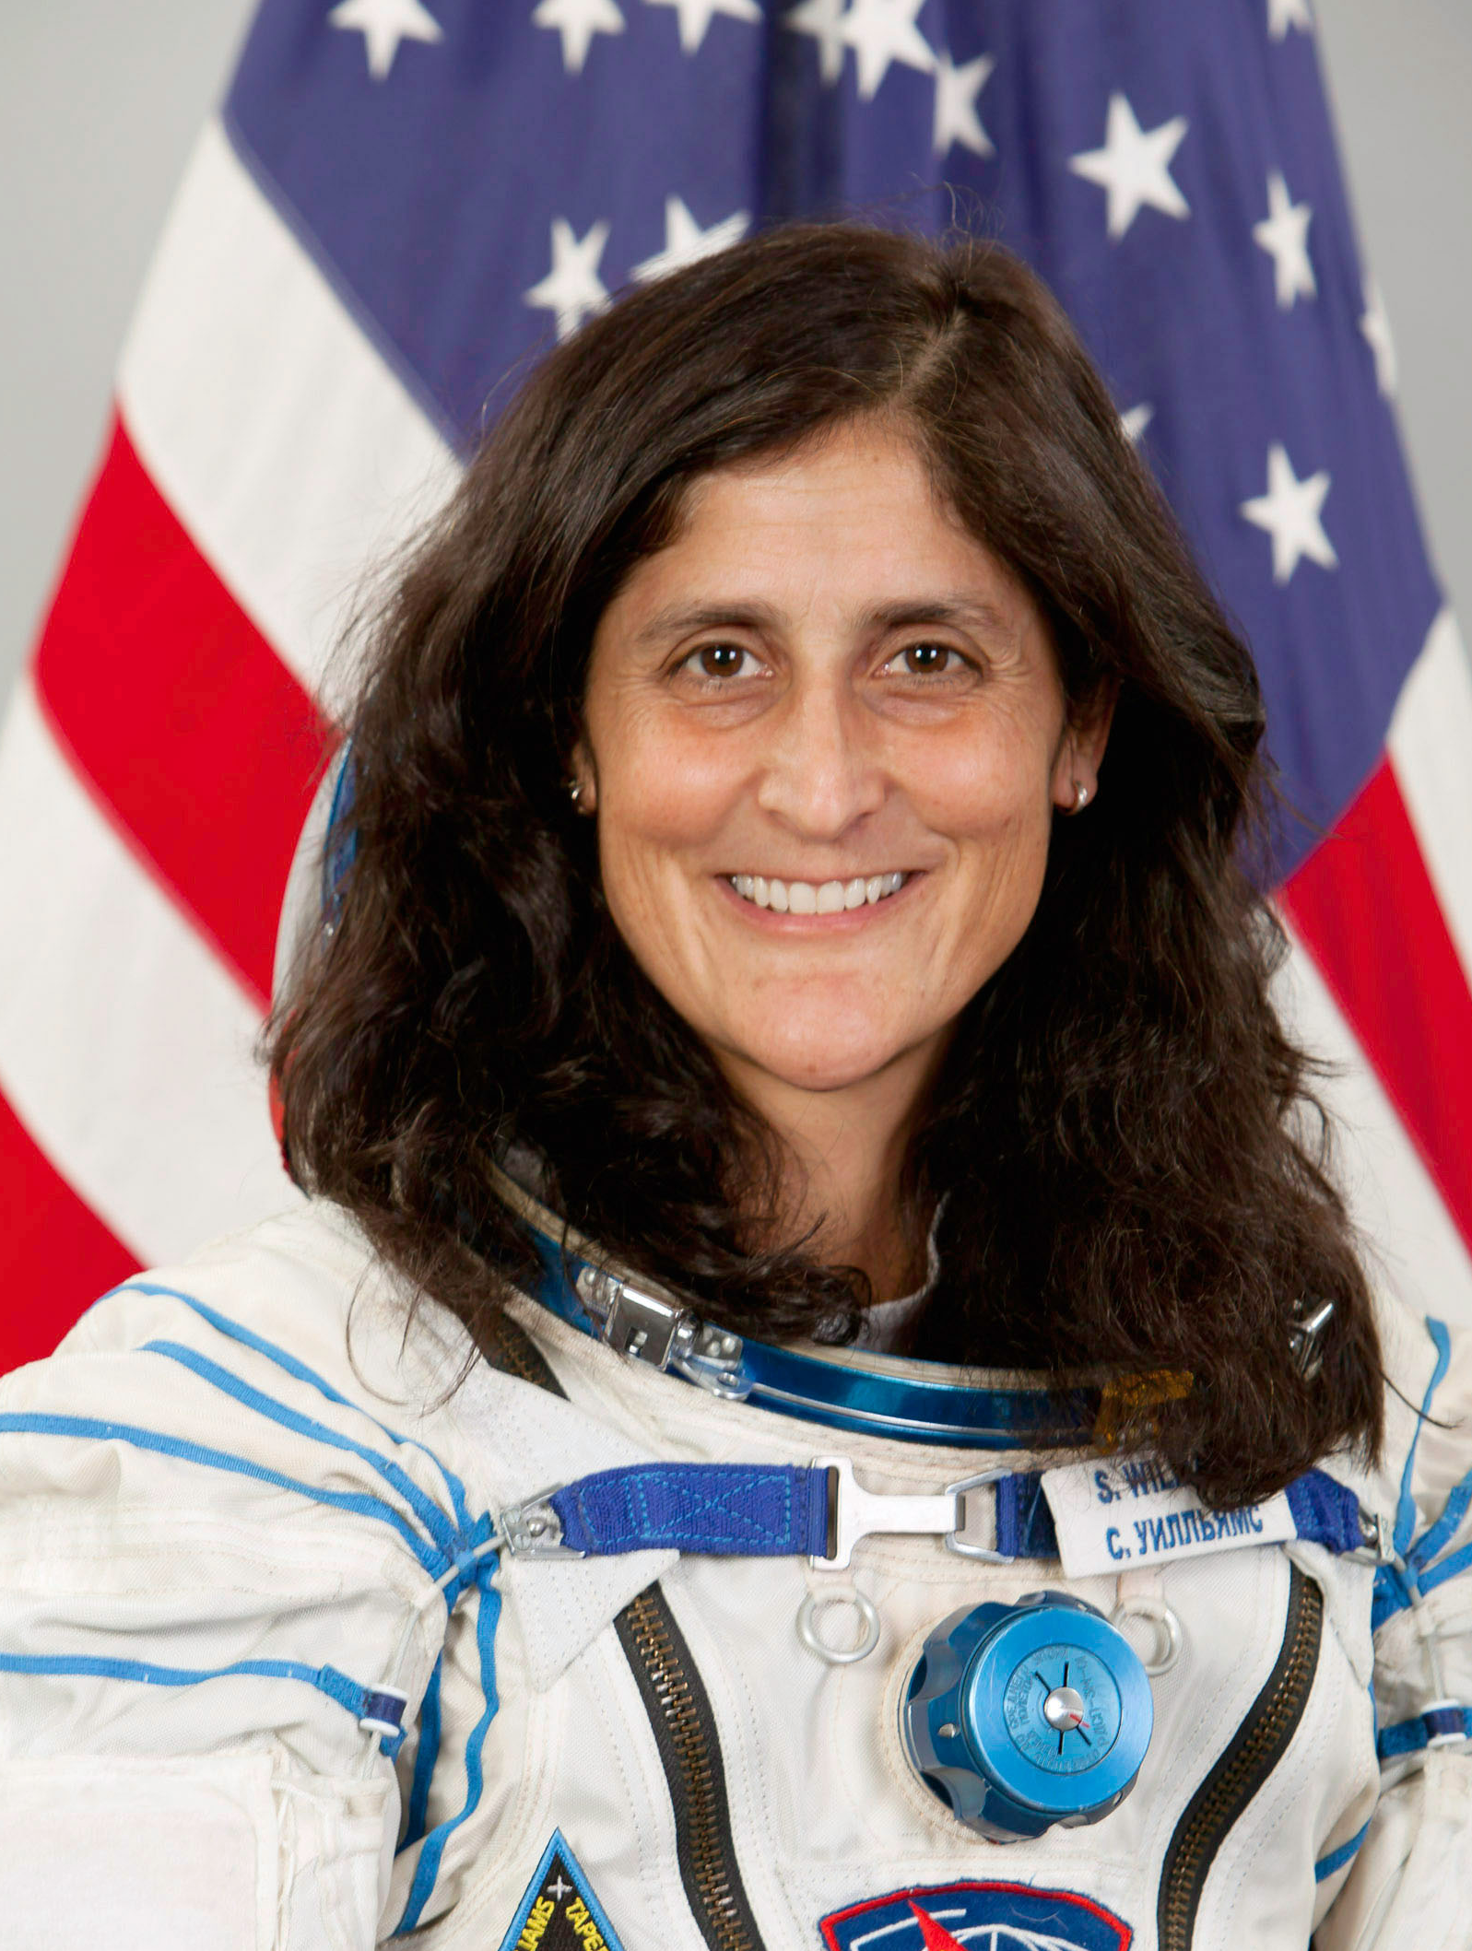
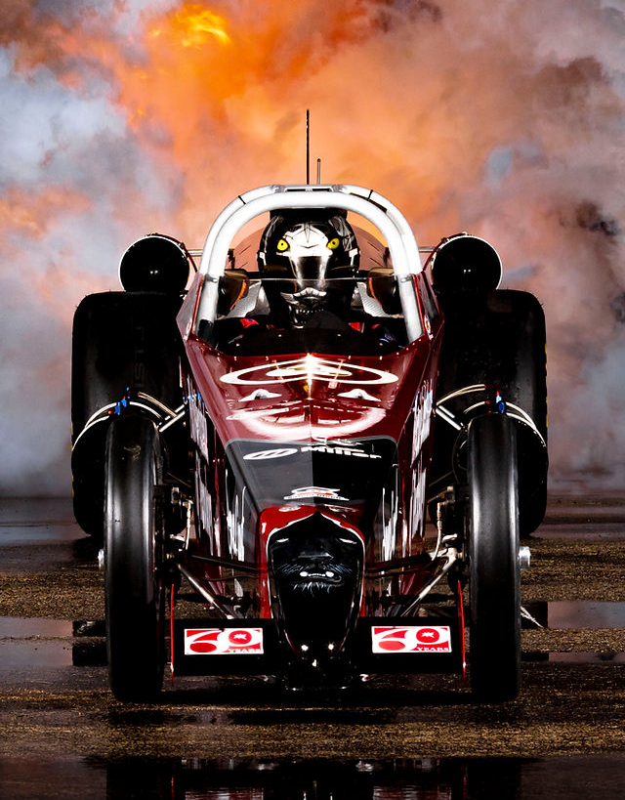
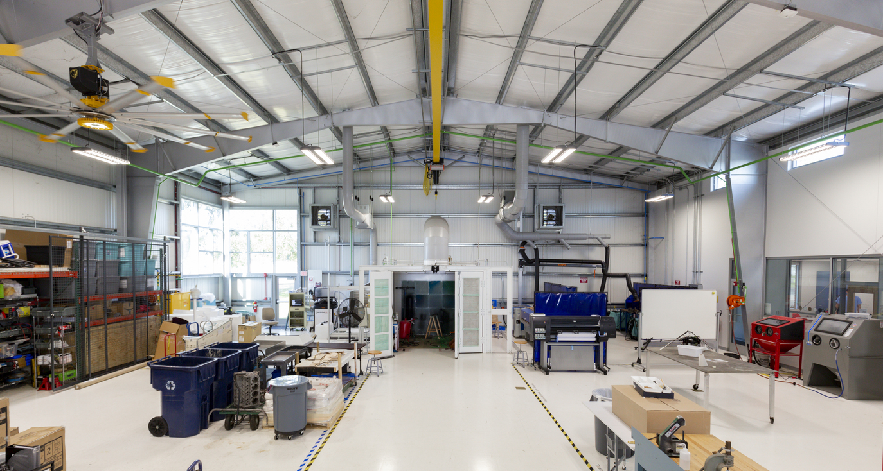
Private, non‑profit STEM university, Melbourne FL
Approx. 10k students, 430 faculty
Space Coast legacy in launch‑era workforce training (37 cents)
Embedded and trusted by the local community and state
Train job‑ready engineers with high graduate employability in NASA/DoD/ commercial space
Programs co‑designed with industry to meet operational needs

Slide 3
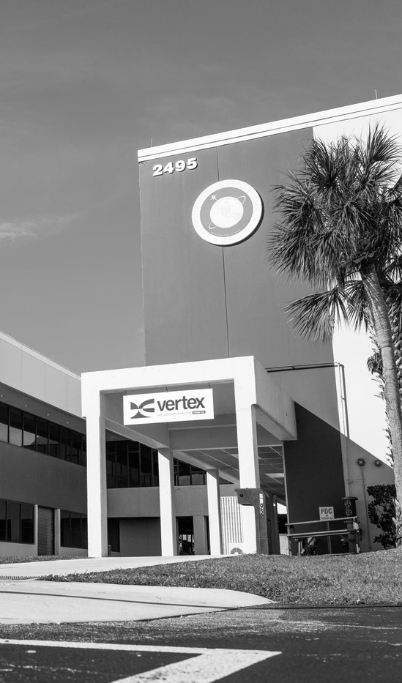
INTRODUCTION TO VERTEX
FLORIDA TECH’S APPLIED INNOVATION HUB
Where industry comes to build, and talent comes to grow.
100,000 sq. ft. facility housing additive manufacturing, advanced visualization, prototyping, advanced materials, electronics, system integration, autonomous flight testing, high-performance computing, collaborative workspaces, classrooms, and tech-focused businesses in residence.
Florida Tech entity dedicated to serving industry partners and driving economic development. Positioned to help businesses solve complex technical problems, train and access talent, and accelerate applied R&D.
Launched 1 year ago, currently active, rapidly expanding with new investments, new capabilities, and mission-aligned partners.
Think interdisciplinary science park + business accelerator = Vertex.

Slide 4

OUR ROLE IN THE
RAPIDLY SCALING SEMICONDUCTOR ECOSYSTEM
Discovery
• Fundamental research
• Materials science
• Device innovation
OUR FOCUS
Applied Development
Validation
Workforce Integration
Deployment
• Manufacturing scale
• Qualification
• Supply chain integration

Slide 5
TRADITIONAL >>> INTERGRATED APPLIED MODEL
Strategic Alignment
Industry-informed priorities
Research & WFD aligned to demand
Clear pathways to application
Operational Integration
Co-location of industry + university
Shared advanced equipment
Applied validation environments (fail fast)
Workforce trained in context
Intentional cross-industry collaboration
Economic Co-Investment
Shared infrastructure investment
Risk distributed across partners
Public-private leverage
PARTNERSHIP
AS INFRASTRUCTURE
FOR SPEED, RISK, & SCALABILITY

Slide 6
WHAT THIS LOOKS LIKE
IN PRACTICE.

Slide 7




















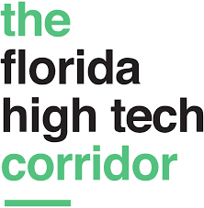



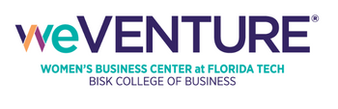





























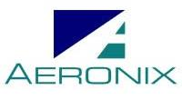




MEMBERS & COLLABORATORS
MAXIMIZING PARTNERSHIPS TO SERVE THE INNOVATION ECOSYSTEM

Slide 8
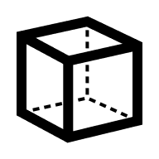


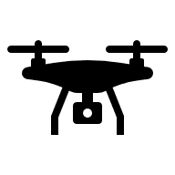



ADDITIVE & 3D PRINTING
Metals, plastics, SLS, Resin, fiber infused, FDM (Equipment highlight: EOS M290, Nicon SLM, Formlabs, Intimsys, Bamboo, Markforged)
ELECTRONICS
Prototyping, test, and validation (Equipment highlight: nScrypt)
DIGITAL ECOSYSTEM
High performance computing, motion tracking cameras, VR headsets, 3D scanners, digital engineering software
EQUIPMENT & TECHNOLOGY OVERVIEW
PROOF OF CONCEPT CASE STUDIES
FREE FLIGHT AUTONOMOUS SYSTEMS TESTING
Indoor drone arena with motion capture and weather simulator (Equipment highlight: Windshapr)
COMPOSITES & ADVANCED MATERIALS*
Comprehensive lab for material prep, manufacturing, post processing, and testing (Equipment highlights: Marrietta NDT-FPS, TEM, AFM, Bruker Poseidon X4 Micro CT, Empire ERGO 3648, Eastman S135, ASC Econoclave, ASC Walk in Oven
MATERIALS & FLIGHT PROCESSING*
ISO class 6 clean rooms, bake out, TVACS
MACHINING*
Mills, grinders, tools (Equipment Highlight: Mitsubishi MV2400-S WIRE EDM)

Slide 9
Key Lessons … So Far
Partnership must be built into infrastructure, not layered on top (picking the right partners)
Early industry engagement reduces downstream friction
Shared applied environments shorten validation cycles
Cross-industry collaboration expands pathways for innovation, application, and talent mobility
What We’re Focused on Next
Expanding shared advanced infrastructure (new labs)
Increasing industry members and HEI collaborators
Deepening industry co-design of workforce pathways & launching new short-course programs
Strengthening cross-sector engagement
Reducing time from research to applied validation
WHAT WE’VE LEARNED
& NEXT PHASE FOCUS AREAS

Slide 10

LET’S BUILD WHAT'S NEXT, TOGETHER.

