Slide 1
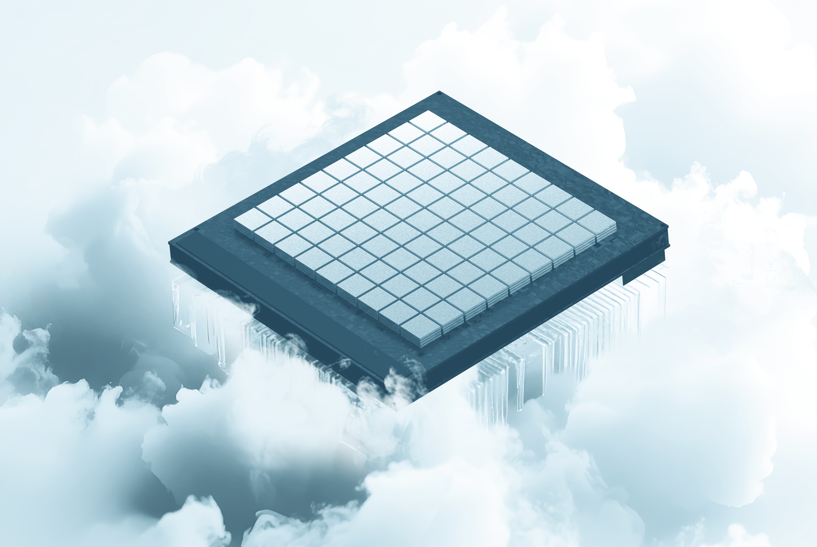


Beyond Semiconductor Digital Compute
A new paradigm in high-performance computing to address the limitations of traditional semiconductors
February 2026

Slide 2


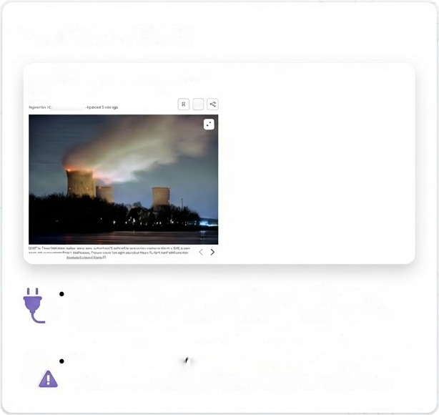
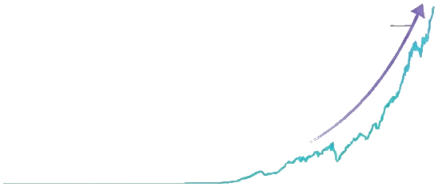


The Scaling Crisis: Demand vs. Power
Computing Power Demand (Exponential Growth
The Energy Crisis
Exponential Surge
ty Recrom
1001 0/17 707
An
Three Mile Island nuclear plant could restart on Microsoft Al power deal
Es EEN Deu the
2010
2015
2020 2025
Major infrastructure deals, restarting nuclear plants, new technologies, captive generation
Rising exponentially, driven by Al Model complexity
Massive investment is needed to keep up with the growth rate of compute demand.

Slide 3

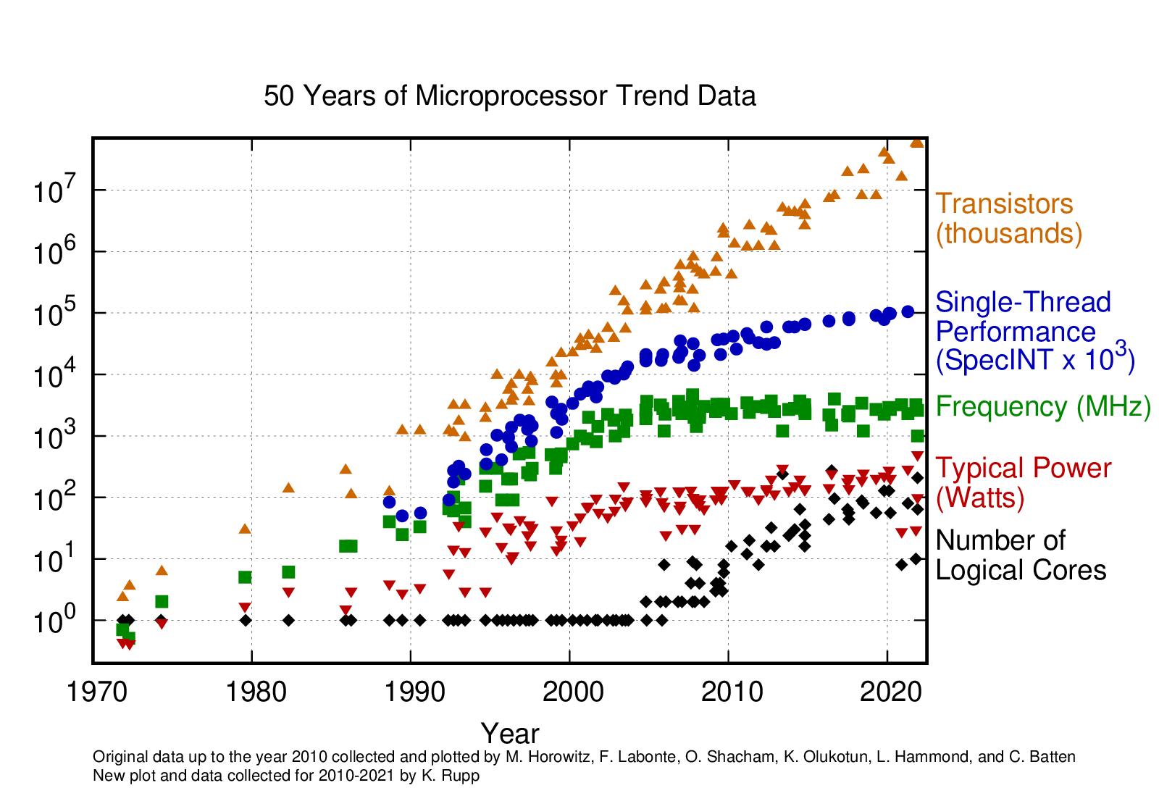



The Stagnation of Semiconductor Progress
Clock frequency peaked
Performance per cm² stagnated
Improvement are now dominated by system level optimization

Slide 4

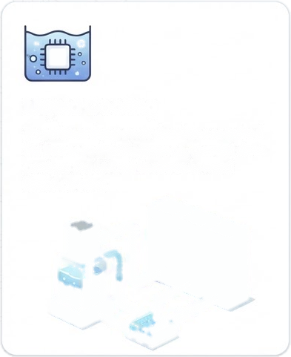
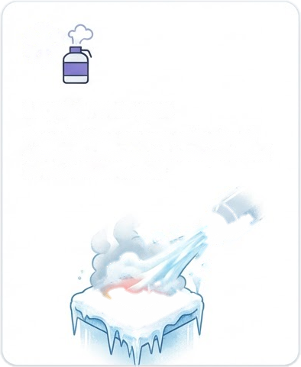
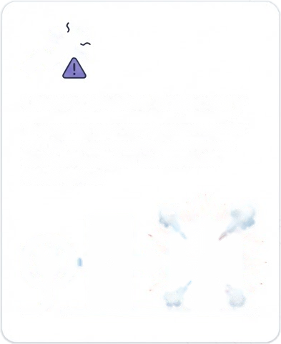



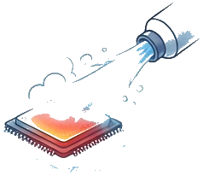
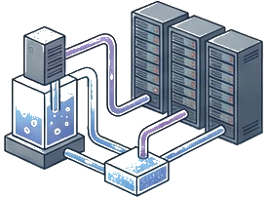
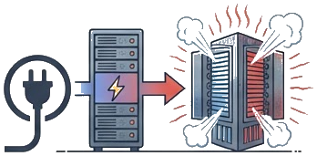
The Cooling Challenge in Modern Data Centers
Focusing on the extreme measures currently used to manage heat
Liquid Cooling
Liquid Nitrogen
Unsustainable Trajectory
To achieve the power densities required for increased performance, current datacenters are forced to move toward liquid cooling
Next generation facilities are adding liquid nitrogen to manage the heat generated by power delivery
The current trajectory is unsustainable as it focuses on pushing more power and then struggling to remove the resulting heat

Slide 5
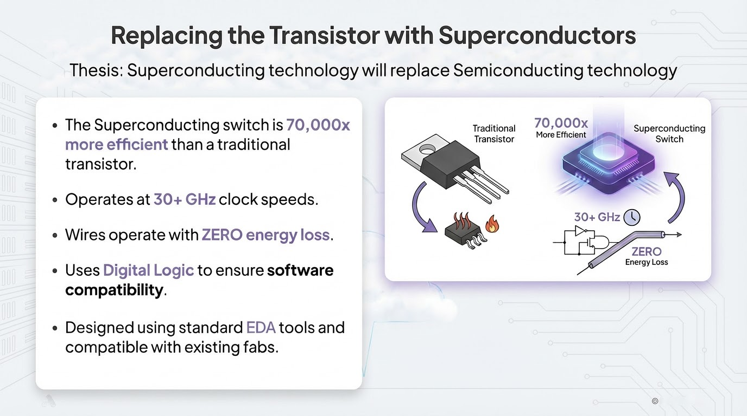

Slide 6
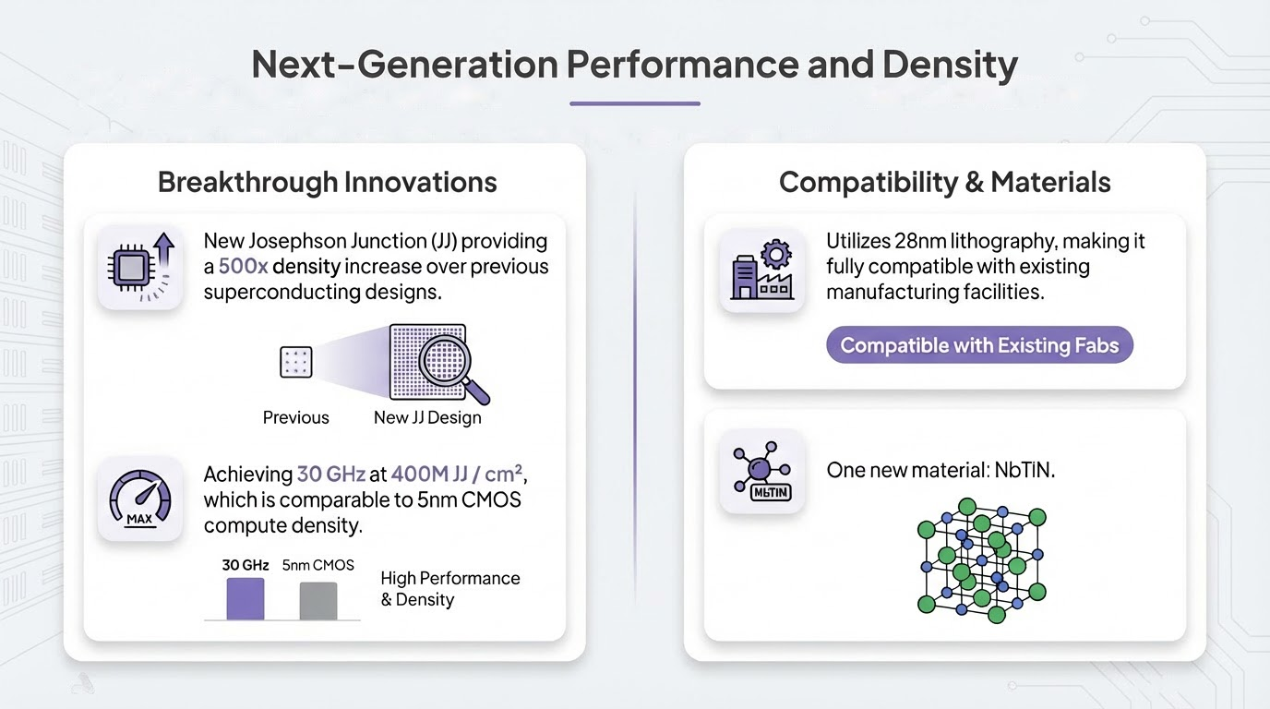
NbTiN
JJ

Slide 7
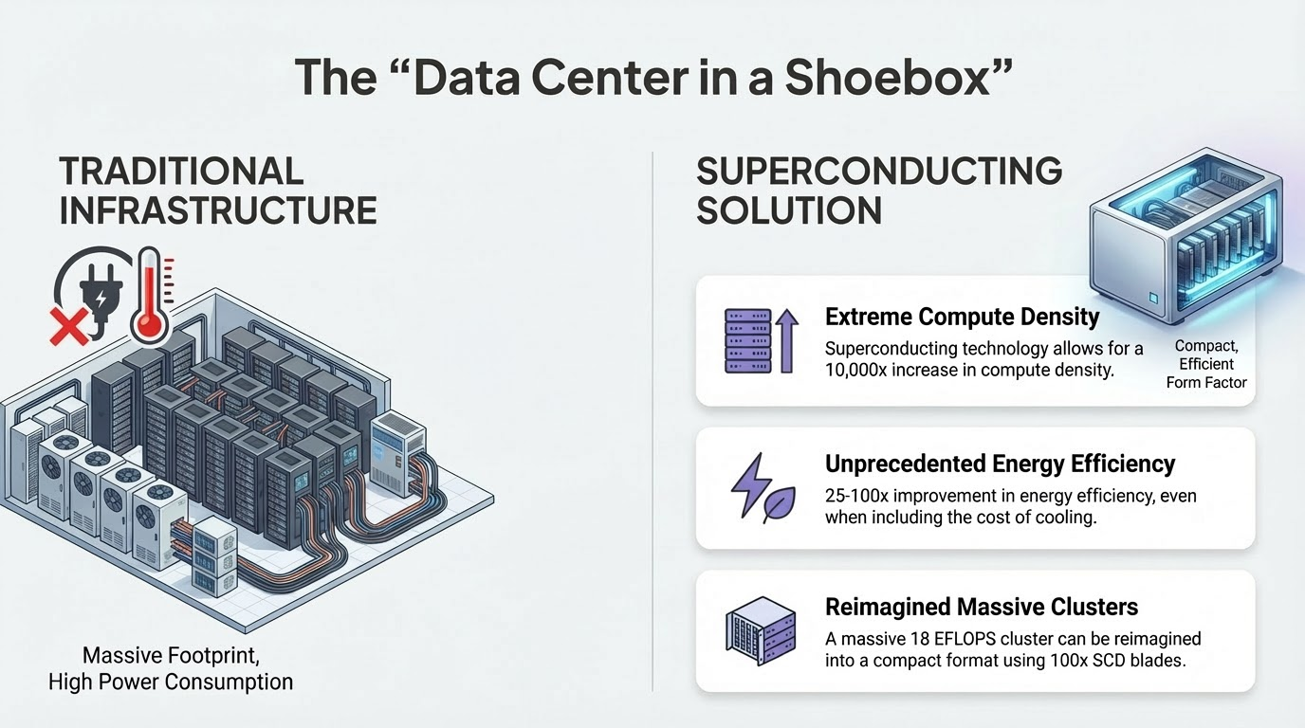
Superconducting technology allows for a 10,000x increase in compute density.
100X improvement in energy efficiency, cooling included!
Reduce dozens of racks of compute to a single machine containing all interconnect.

Slide 8

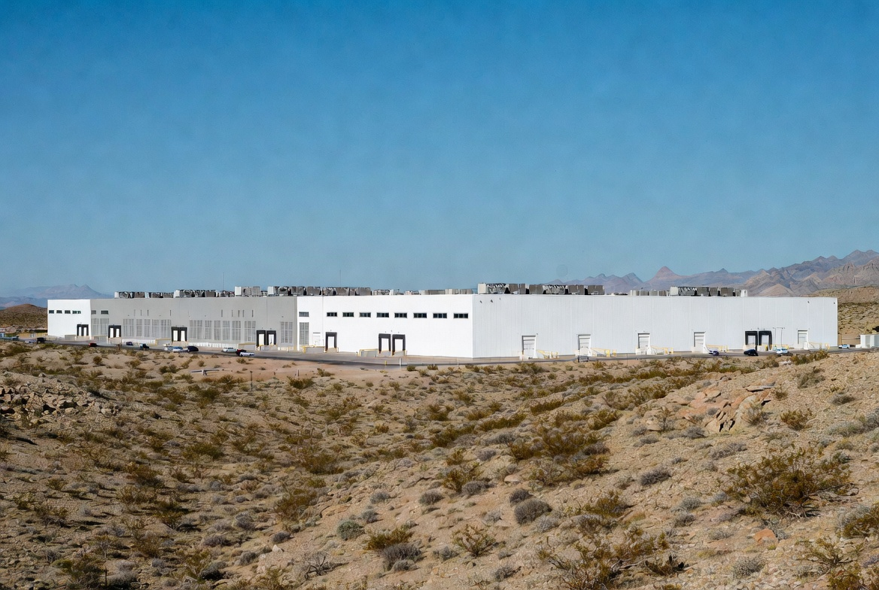

A New Approach: The Snowcap Approach
000
TRADITIONAL Approach
SNOWCAP Approach
Massive Footprint, High Power
Unsustainable energy and cooling demands
Social pushback – Not in my backyard!
Cryogenic-First Design
Remove heat first, then add only the power required — delivering extreme efficiency at scale.

Slide 9
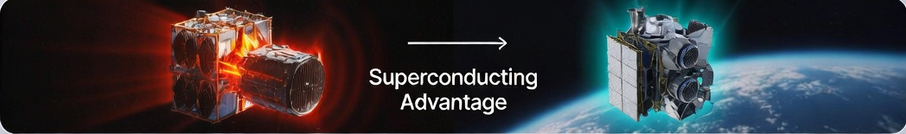




Data Centers in Space
Space Is Not Cold
Don't Generate the Heat
Only radiative heat control
Limit power per satellite
Lower Power, Lower Heat
Superconducting Advantage
Lower mass, lower cost
Maintain performance, RadHard

Slide 10
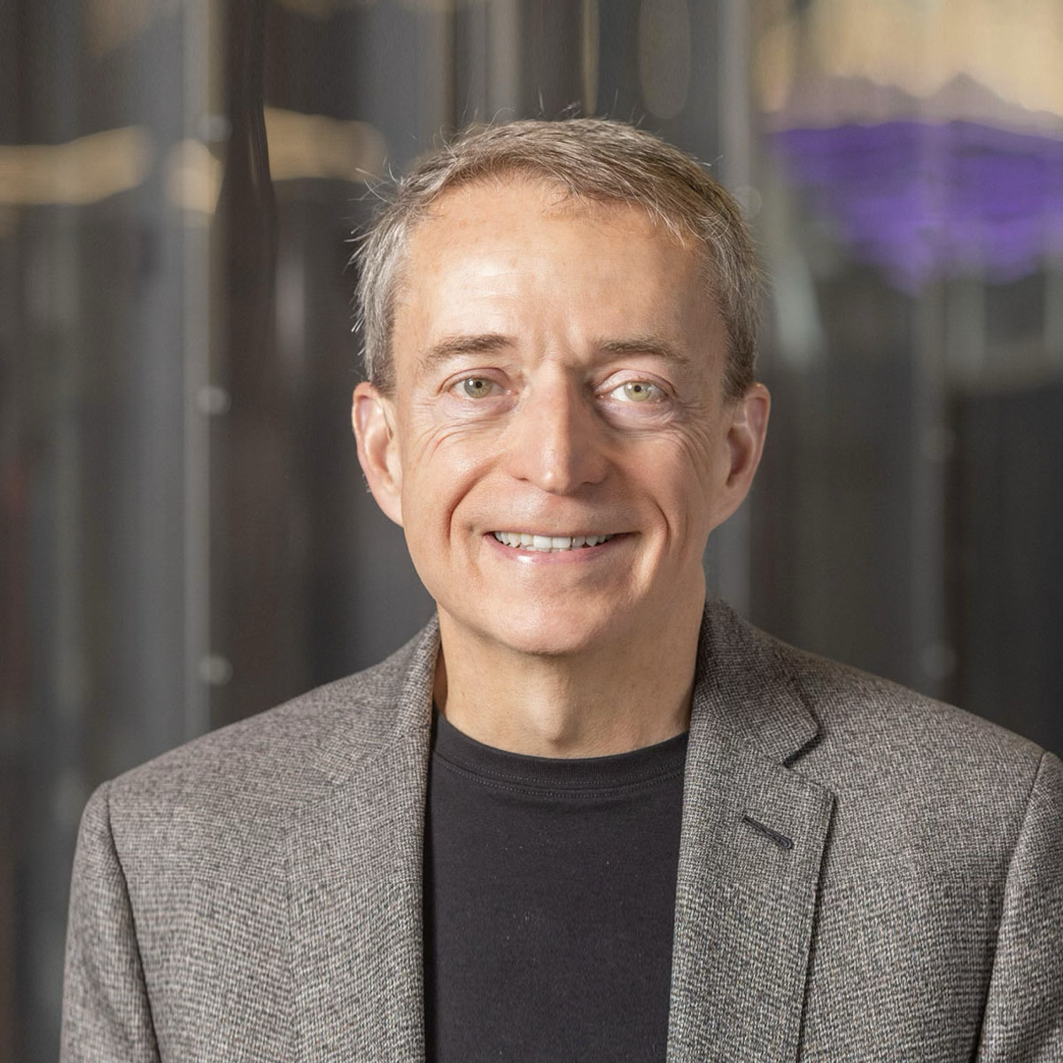

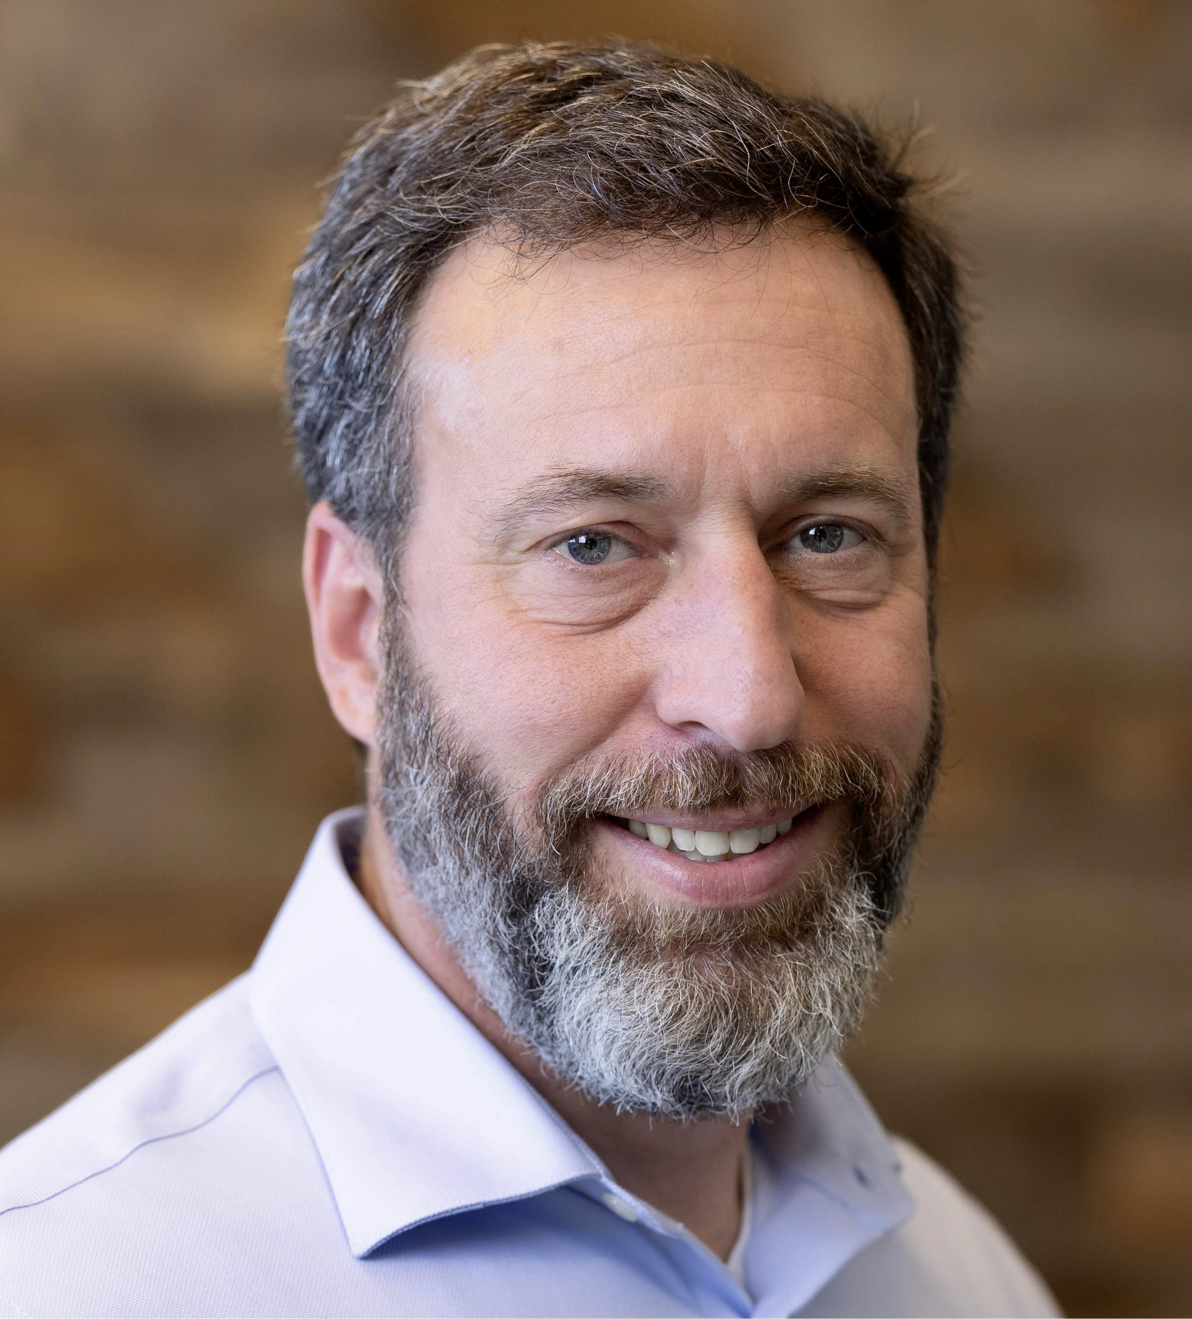

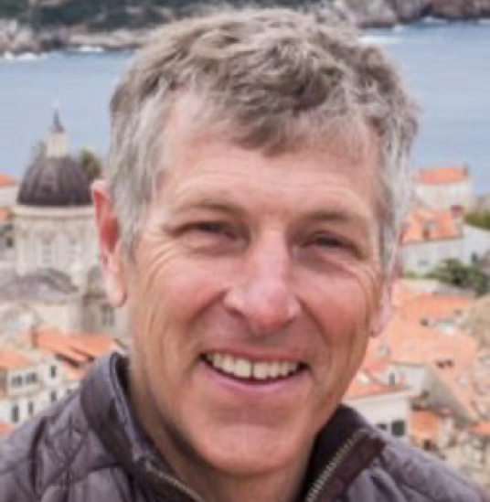
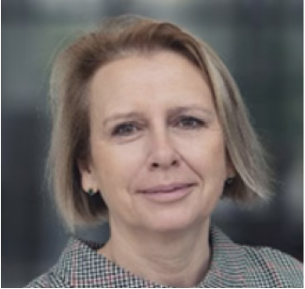

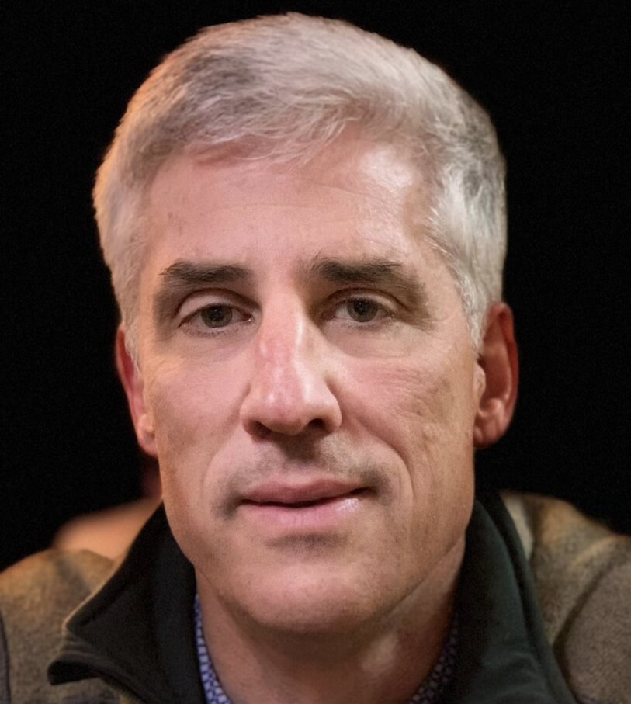
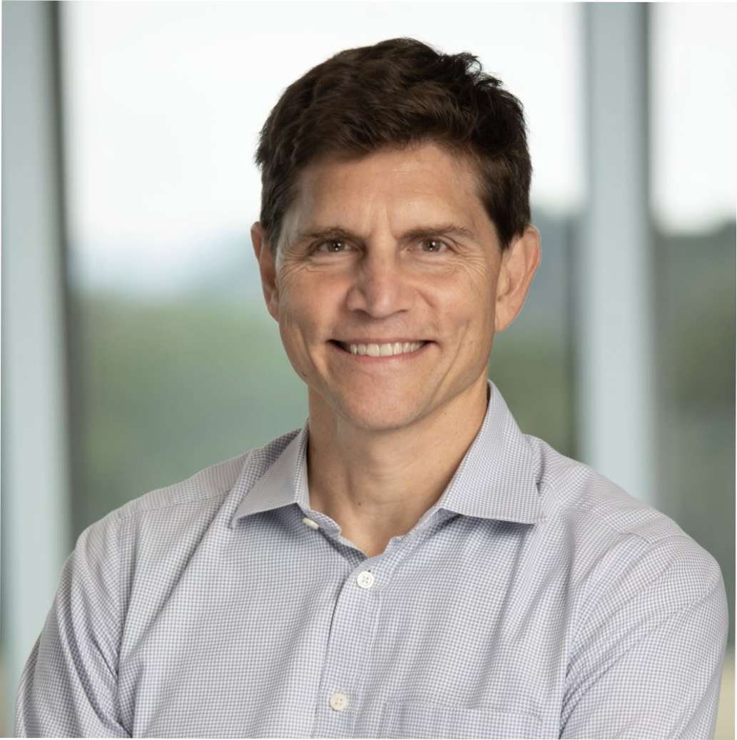
Leadership Team
Mike Lafferty
Pat Gelsinger
Cadence –Solutions Group Director
Galtronics Telemetry - CTO
Playground Global – GP
Intel – CEO
VMWare - CEO
Team
Anna Herr, PhD
Rick Hyman
Imec – Scientific Director
Northrop Grumman – Fellow
Swedish Academy of Sciences - Fellow
Nvidia – VP of Business Development
Quentin Herr, PhD
Brian Kelleher
Imec – Scientific Director
Northrop Grumman – Fellow
Inventor of scalable superconducting logic
Nvidia – SVP of HW Engineering
Our team brings deep expertise in superconductors and semiconductors to revolutionize digital compute.

Slide 11
The Future of Computing
Thank you for your time.
www.snowcapcompute.com

