Slide 1
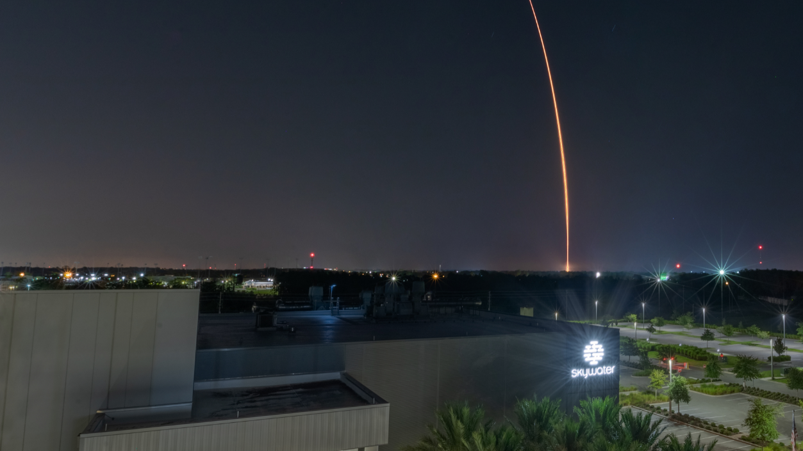

Building the Future
of Advanced Packaging in Florida
FLORIDA SEMICONDUCTOR SUMMIT | FEB 24, 2026

Slide 2
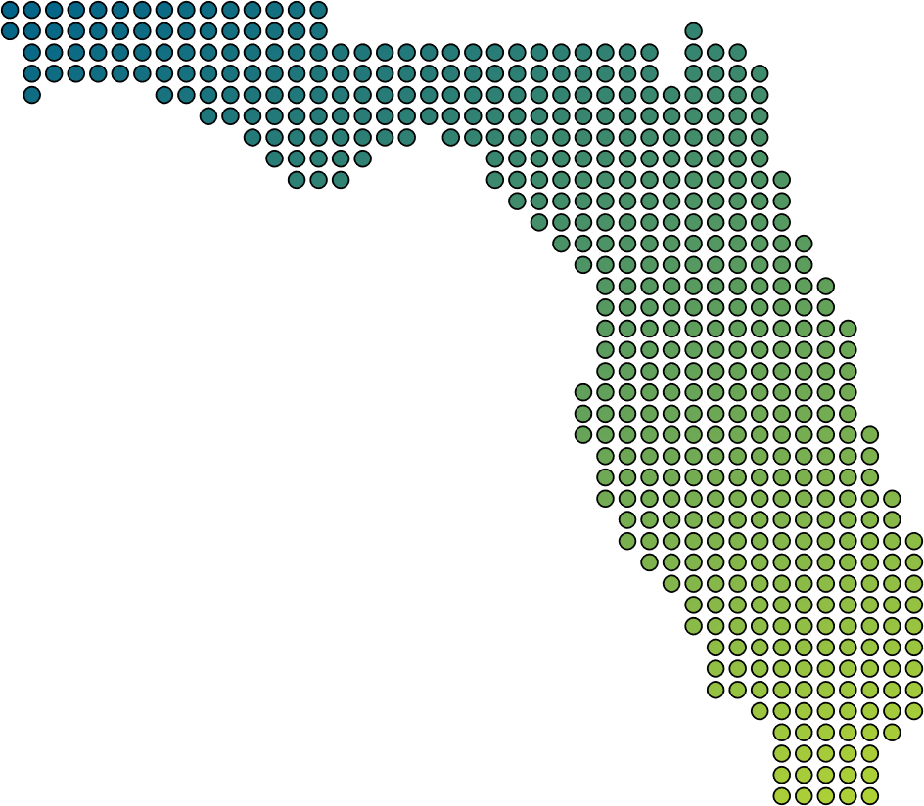
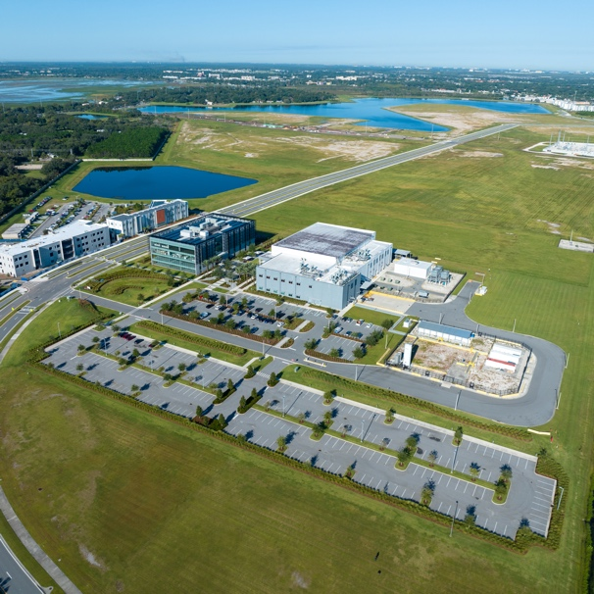
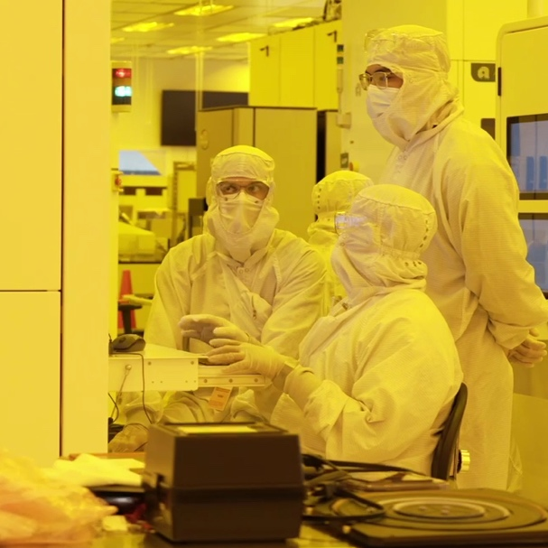

Central Florida:
An Emerging Microelectronics Hub
INFRASTRUCTURE
TALENT
MOMENTUM
©2026 SkyWater Technology. Proprietary.

Slide 3

Advanced Packaging is Now
Strategic Infrastructure
1
System performance is no longer driven
by Moore’s Law alone
2
Packaging is now a driver of system performance
3
Location matters
©2026 SkyWater Technology. Proprietary.

Slide 4
Fan Out Wafer Level Packaging is a
National Capability
HIGHER DENSITY
BETTER PERFORMANCE
SCALABLE FOR VOLUME
RESILIENCE
SECURITY
COMPETITIVENESS
©2026 SkyWater Technology. Proprietary.

Slide 5
Current Plan of Record
Advanced Packaging Platform Roadmaps
HYBRID WAFER BONDING
200mm W2W DBI
200/300mm D2W DBI
2025
2026
2027
2028
SILICON INTERPOSER
200mm Si Interposer
Advanced Features
2025
2026
2027
2028
FAN OUT WAFER LEVEL PACKAGING
Single-sided FOWLP prototypes
Dual-sided FOWLP prototypes
Qualified & production-ready
2025
2026
2027
2028
©2026 SkyWater Technology. Proprietary.

Slide 6
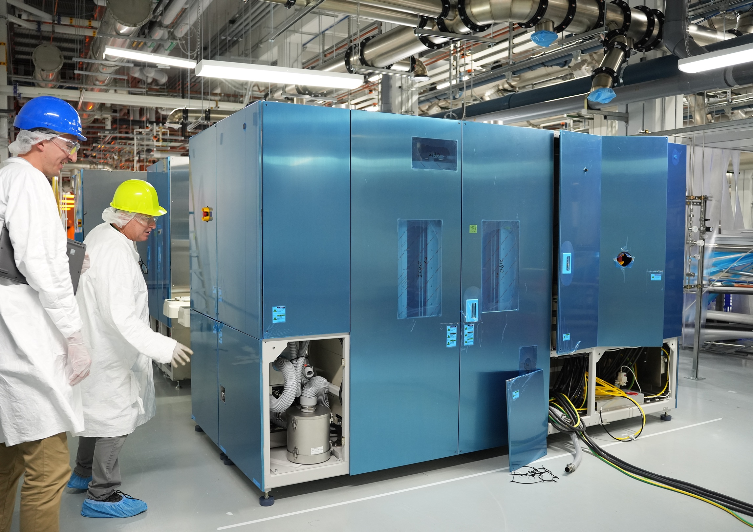
Progress You Can See
Building Momentum on the Ground
1
3
Facility expansion
Technology transfer
2
4
Tool installation
Increased staffing
©2026 SkyWater Technology. Proprietary.

Slide 7
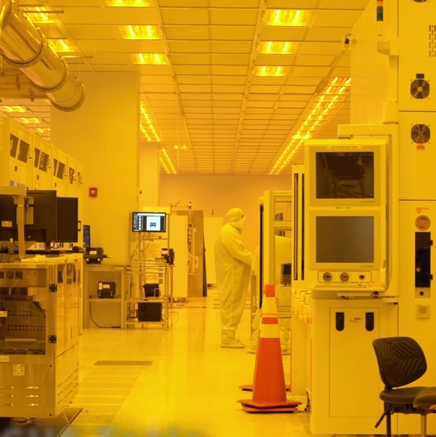
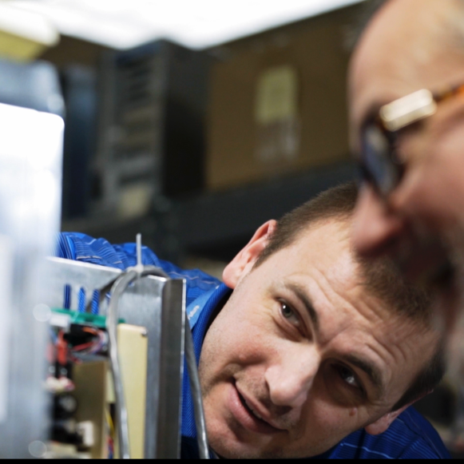
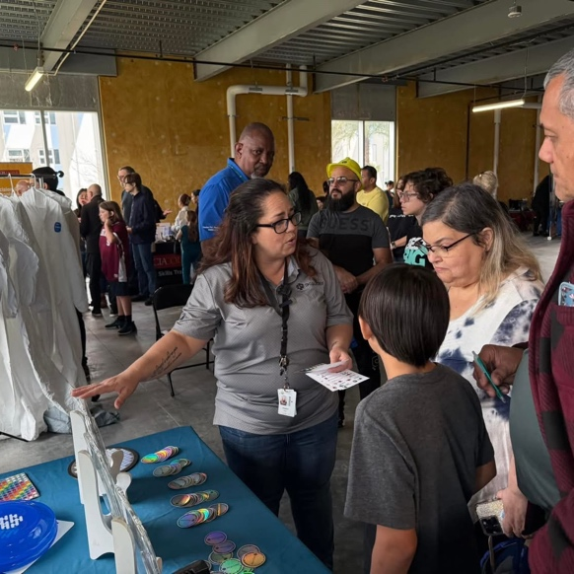
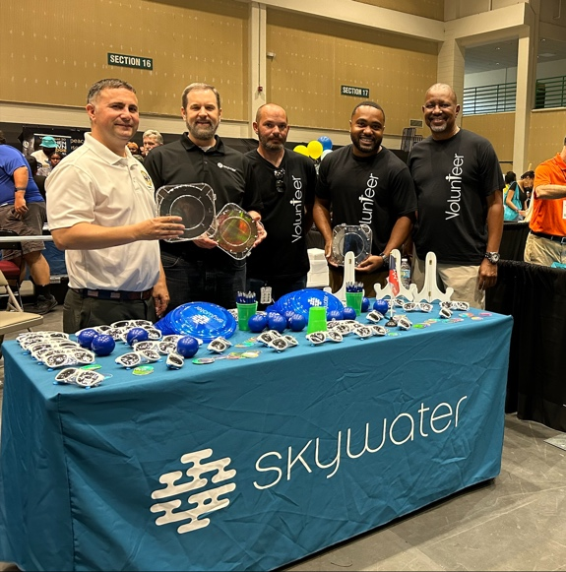
Advanced Manufacturing Requires
Advanced People
SKILLS GAP
HANDS-ON TRAINING
CAREER PATHWAYS & DEVELOPMENT
RETENTION & CULTURE
©2026 SkyWater Technology. Proprietary.

Slide 8
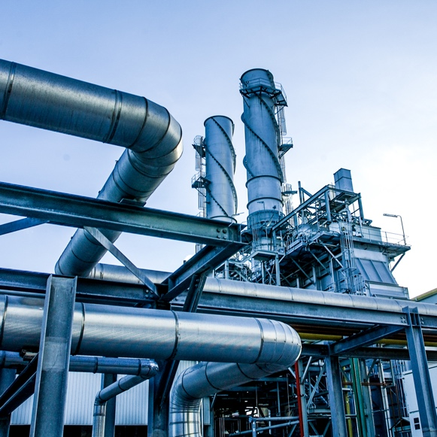
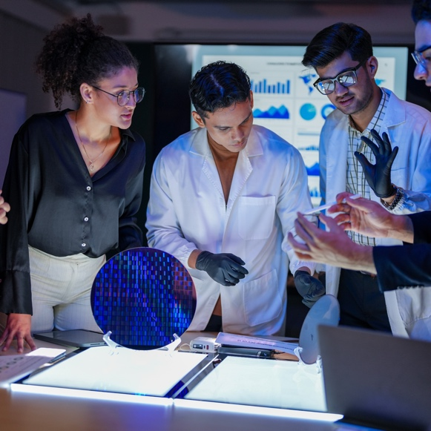

No One Builds This Alone
Advanced Packaging is an Ecosystem Play
INDUSTRY
ACADEMIA
GOVERNMENT
©2026 SkyWater Technology. Proprietary.

Slide 9
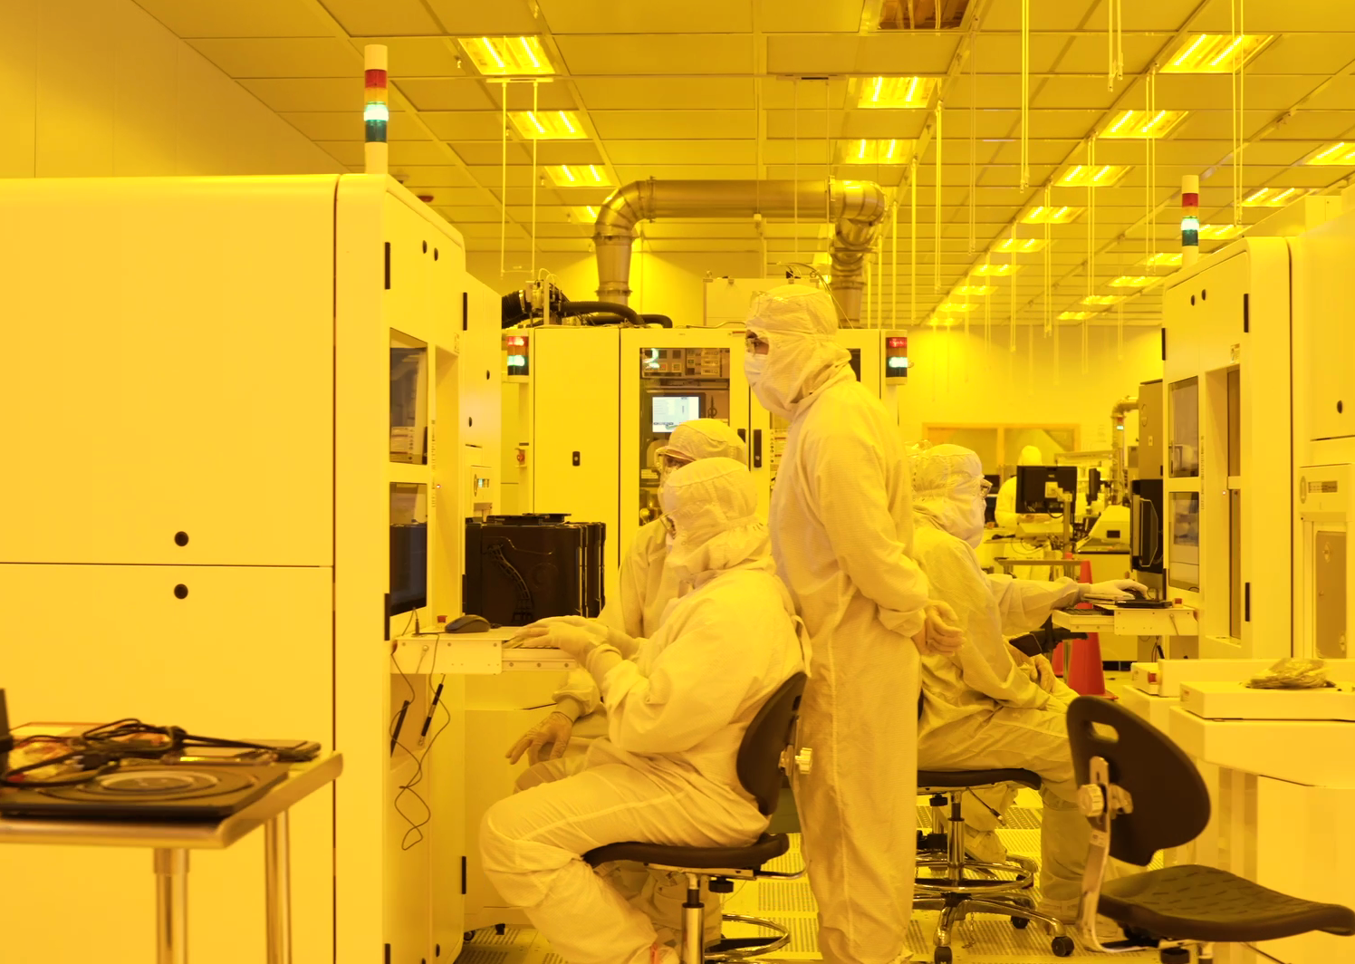
When Collaboration Works,
Everyone Wins
1
Faster R&D
2
Shared risk
3
Scaled impact
©2026 SkyWater Technology. Proprietary.

Slide 10

IonQ to Acquire SkyWater
1
Shared commitment to advanced technology leadership
2
+
Continued focus on U.S.-based manufacturing
3
SkyWater remains fully committed to its foundry customers
©2026 SkyWater Technology. Proprietary.

Slide 11
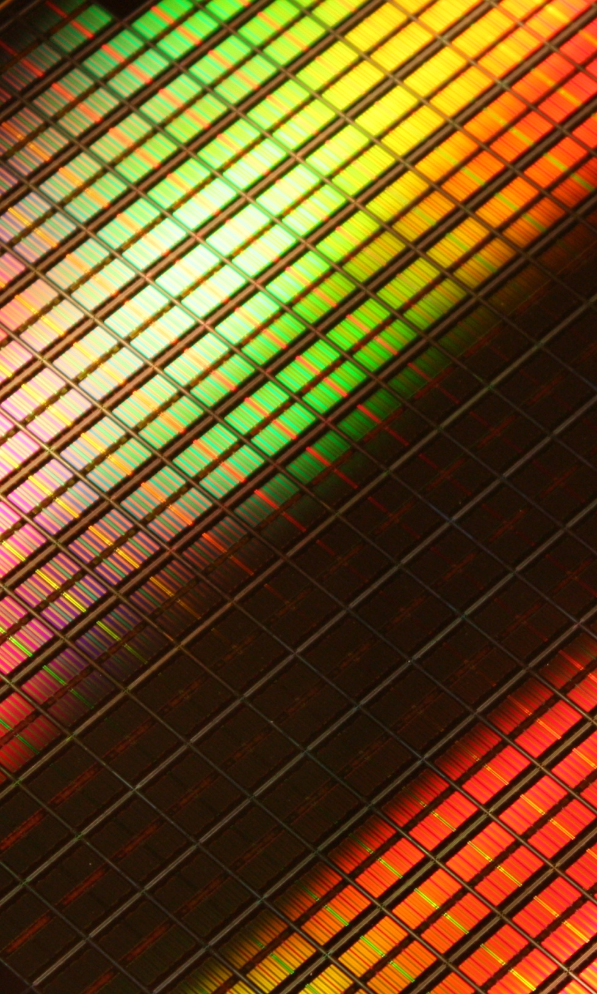
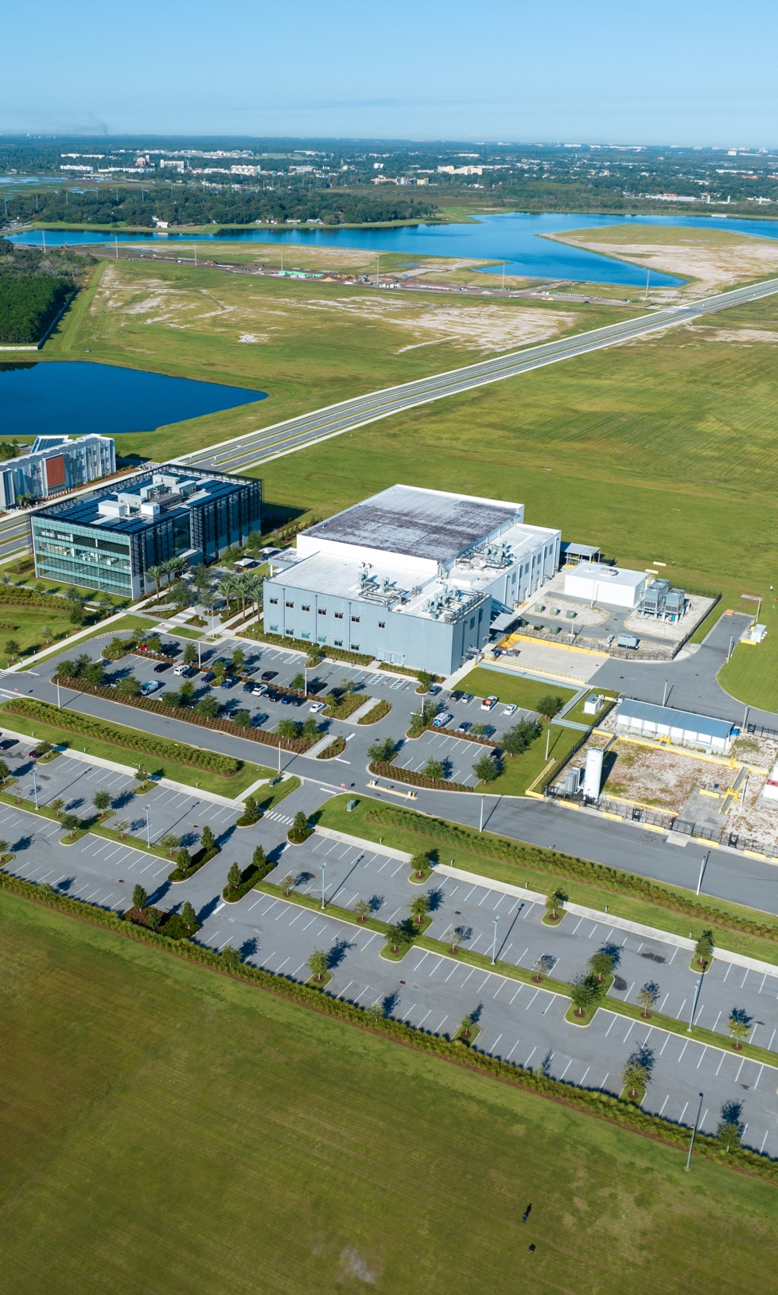
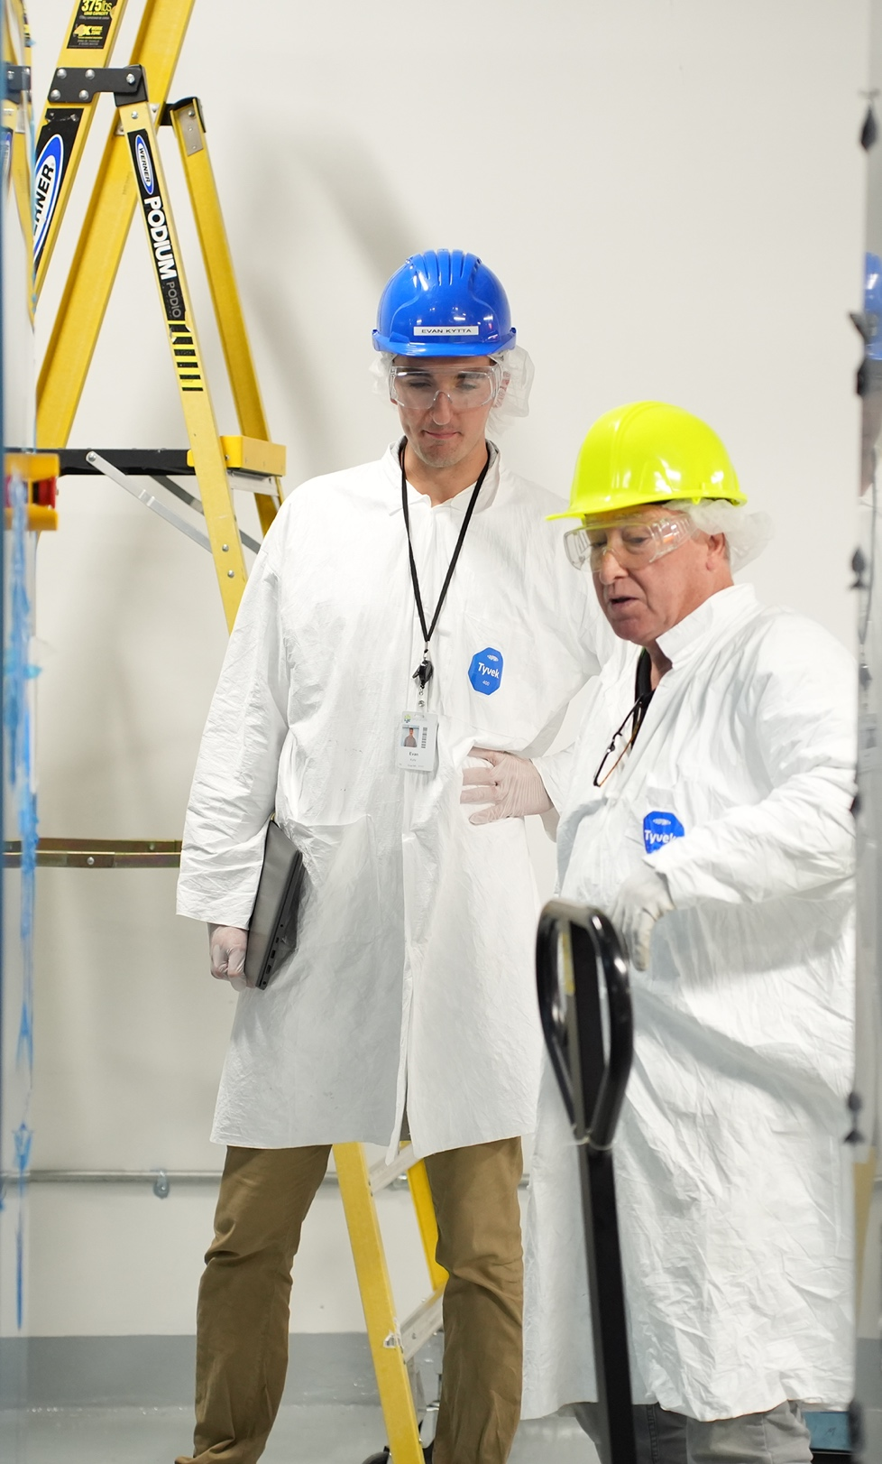
Building What Comes Next,
Together
NATIONAL
CAPABILITY
REGIONAL
OPPORTUNITY
FUTURE-READY
WORKFORCE
©2026 SkyWater Technology. Proprietary.

